Slide 1
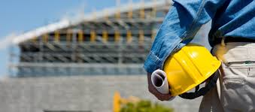


Autoclaved Aerated Concrete Market Research in Europe and Germany, 2017-2027
Prepared For
Prepared By
MARKET INTELLIGENCE . CONSULTING
www.techsciresearch.com

Slide 2
Table of Contents
S. No. | Contents
1. | Product Overview
2. | Research Methodology
3. | Executive Summary
4. | Europe Autoclaved Aerated Concrete Market Outlook
 | 4.1. | Market Size and Forecast
 |  | 4.1.1. | By Value
 |  | 4.1.2. | By Product Type (Block, Roof Panel, Wall Panel, Cladding Panel)
 | 4.2. | Market Share and Forecast by Volume
 |  | 4.2.1. | By Product Type (Block, Roof Panel, Wall Panel, Cladding Panel)
 |  | 4.2.2 | By Size
 |  | 4.2.3 | By End User
 |  | 4.2.4 | By Application
5. | European Market Dynamics | Real Fur Market Price Trend and Forecast | By Company
 | 5.1. | Drivers | By Value
 | 5.2. | Challenges
6. | European Market Trends & Developments
7. | European Competitive Landscape – Top 10 AAC manufacturing equipment makers in 2020
 | 7.1. | Revenue Ranking & Market Share
 | 7.2. | Company Profile
 |  | 7.2.1. | Company Details
 |  | 7.2.2. | Products and Services

Slide 3
Table of Contents
S. No. | Contents
 |  | 7.2.3. | Financials
 |  | 7.2.4. | Key Market Focus & Geographical Presence | Mud and snow tires/ M+S tires
 |  | 7.2.5. | Recent Developments | Studless Tires
 |  | 7.2.6. | Key Management Personnel | Chains
8. | Country Analysis: Germany
 | 8.1. | Market Size and Forecast
 |  | 8.1.1. | By Value
 |  | 8.1.2. | By Product Type (Block, Roof Panel, Wall Panel, Cladding Panel)
 | 8.2. | Market Share and Forecast by Volume
 |  | 8.2.1. | By Product Type (Block, Roof Panel, Wall Panel, Cladding Panel)
 |  | 8.2.2. | By Size
 |  | 8.2.3. | By End User
 |  | 8.2.4. | By Application
9. | Germany Market Dynamics | Real Fur Market Price Trend and Forecast | By Company
 | 9.1. | Drivers | By Value
 | 9.2. | Challenges
10. | Germany Market Trends & Developments
11. | German Competitive Landscape | 8.1.2. | By Volume
 | 11.1. | Competitive Outlook
 | 11.2. | Company Profile: Xella
 |  | 11.2.1. | Company Revenue Analysis by Product Type (Block, Roof Panel, Wall Panel, Cladding Panel)

Slide 4
Table of Contents
S. No. | Contents
12. | Sustainable Use of Autoclaved Aerated Concrete ( This chapter will contain details of any AAC products available which has material emitting less CO2. (1) AAC manufacturing technology to reduce CO2 emissions in all processes related to AAC manufacturing (from raw material manufacturing to AAC manufacturing). (2) Technology that reduces CO2 emissions when using AAC. (For example, Thermal Insulation Property) Any examples of research and developing of these products? Any examples of marketing and selling of AAC products emitting less CO2.
13. | Inter-corporation CO2 emission trading in Europe ( Qualitative ) ( This chapter will contain the following : Whether companies sell their CO2 emission rights to other companies? Amount of money spent in CO2 emission right trading( total or average)? CO2 emission right trading amount may soon exceed European per tonne penalty charged by EU government, which will make it cheaper to just pay penalty. How do European companies think about this situation?
14. | Subsidy system in Europe ( Qualitative ) ( This chapter will contain details of whether EU Government or any member Country’s Government have any subsidies for companies' sales or R&D activities of Autoclaved Aerated Concrete made of materials with reduced amount of CO2 emission?
15. | Strategic Recommendations

Slide 5

PRODUCT OVERVIEW & SCOPE OF ANALYSIS

Slide 6
Scope of Report
Autoclaved aerated concrete is a type of precast concrete, a lightweight construction material mainly used for producing concrete masonry units like blocks, block, lintel, floor and roof panel, wall panel, cladding panel, tile, and others. Autoclaved aerated concrete blocks are made by proportioning calcareous materials (cement and lime), siliceous materials (sand, slag and fly ash) and air entraining admixture (aluminum powder), and then mixing, casting, gas-developing, cutting and autoclaving them.
MARKET SEGMENTATION
By Product Type
By Application
Block
Lintel
Floor Elements
Roof Panel
Wall Panel
Cladding Panel
Others
Year Range
Construction Materials
Road Construction
Roof Insulation
Bridge Sub-Structure
Void Filling
Review Period
2017 – 2020
Base Year
2021
Estimated Year
2022
Forecast Period
2023 –2027
MARKET OUTLOOK
(EUROPE)
By Size
By End User
Small
Medium
Large
Commercial
Residential
Infrastructure
Industrial
By Product Type
By Size
By Application
Block
Lintel
Floor Elements
Roof Panel
Wall Panel
Cladding Panel
Others
Small
Medium
Large
Construction Materials
Road Construction
Roof Insulation
Bridge Sub-Structure
Void Filling
MARKET OUTLOOK
(GERMANY)
By End User
Commercial
Residential
Infrastructure
Industrial

Slide 7
Product Overview & Definition
Autoclaved Aerated Concrete, also known as AAC, is a lightweight building material that is used widely in Asia, Europe & all over the world. It was first made in Sweden in the 1920’s and has been used as a building material ever since. AAC, Autoclaved Aerated Concrete, is a pre-cast concrete that is lightweight due to gas bubbles that form and are trapped in it due to a chemical reaction between the ingredients. The material should undergo a final curing process in an autoclave oven before being used.9 The manufacturing process of AAC includes mixing of the ingredients - Portland cement, fly ash, lime, sand, water and aluminum powder or paste - and then pouring them into a mold. The chemical reaction between the lime and aluminum produces microscopic hydrogen bubbles. Creation of the hydrogen gas and therefore bubbles in the structure of the AAC increases the volume of the final product from 33% to up to five times its raw materials original volume. The product then is cut using a set of thin wires and cured in an autoclave. The final AAC product can be used for wall, floor, roof, cladding, and other purposes
Composition:
2Al + 3Ca (OH)2 + 6H2O3 + CaO+ Al2O3 + 3H2
Aluminum powder + Hydrated lime Tricalcium hydrate + Hydrogen. (Water, cement quicklime, aluminum powder, and sand) 0.6-0.65%, 10-20% 20%, 8%, 3%, 69%
CO2 emissions:
1.5 kg of CO2 is emitted for every 1 sq. ft of carpet area of AAC blocks
Advantages:
Lightweight which reduces the dead load of the structure
Environmentally friendly building material due to less use of cement
Available in large and various sizes
Thermal insulation which keeps interior in summer and winter in moderate temperatures
Sound proofing
Fire resistance
Long-term savings of construction costs
Easy installation, AAC blocks are easy to handle and cut on site
Less steel is used due to low density
Time-saving in construction
Disadvantages:
The production cost is higher than the traditional bricks.
The surface of AAC blocks is smooth, thus the mortar might not stick.

Slide 8

RESEARCH METHODOLOGY

Slide 9
Research Methodology
The recommended methodology for this study is based on exhaustive Secondary Research followed by extensive Primary Research. TechSci Research will deploy a dedicated team who will work dedicatedly for the Client to meet research objectives.
Phase-I: Secondary Search
The team will conduct exhaustive secondary research to collect the information on required set of data /information
Phase-II: Formulating Questionnaire & Developing List of Respondents
Based on understanding developed though secondary Search, TechSci team will formulate a guideline and develop list of respondents to ask specific questions related with the project objectives for each type of stakeholders (Manufactures , Distributors/ Traders/ Exporters / Importers , Government/ Research/ Regulatory Organisations, Institutional Buyers and Associations and Industry experts.
Phase-III: Extensive Primary Search
TechSci Research will execute primary surveys targeting key participants including industry experts through Telephonic methodology. TechSci Research will perform periodical checks on data being collected through field surveys with logic checks and analyze survey results
Below mentioned is the distribution of surveys that would be conducted during the study :
 | Key Stakeholders :
Country | Manufactures | Suppliers/ Distributors | Industry Experts
Europe | 25 | 30 | 8
Germany | 10 | 20 | 2
We do multiple interviews in one organisation at different levels (Mid-Senior) and departments (Sales, Marketing, Production, etc)

Slide 10









Research Methodology
Target Audience Identification
Questionnaire Design and Finalization
Survey Execution
Data Cleaning and Validation
Survey Analysis
Reporting
Copyright © TechSci Research
Phase-IV: Analysis of Information Developed and Submission of Report
TechSci will do the analysis of collected set of information for target products and summarize key findings to be submitted to client in the form of Report

Slide 11
Research Methodology
Partial List of Key Secondary Sources to be Considered | Partial List of Key Primary Sources to be Considered
World Bank TechSci Research Proprietary Database & Knowledge Repository Company Annual Reports Industry Magazines Industry Reports News Dailies Credible Paid Databases EAACA (European Autoclaved Aerated Concrete Association) AAC Worldwide7 FISSAC (Fostering Industrial Symbiosis for a Sustainable Resource Intensive Industry across the extended Construction Value Chain) | Xella Group Mannok H+H International A/S Bauroc SAS Aircrete Europe Wehrhahn GmbH Domapor Baustoffwerke GmbH and Co.KG Ekoru SRL Forterra PLC Hansa Baustoffweke Parchim GmbH Schlamann KG Solbet Group

Slide 12
EXECUTIVE SUMMARY

Slide 13
Europe Autoclaved Aerated Concrete Market Outlook, 2022E
Europe Autoclaved Aerated Concrete Market Share, By Product Type, By Value, 2022E
Europe Autoclaved Aerated Concrete Market Share, By End User, By Value, 2022E
Europe Autoclaved Aerated Concrete Market Share, By Region, By Value, 2022E
Europe Autoclaved Aerated Concrete Market Share, By Application, By Value, 2022E
Source: TechSci Research

Slide 14
Germany Autoclaved Aerated Concrete Market Share, 2022E
Germany Autoclaved Aerated Concrete Market Share, By Product Type, By Value, 2022E
Germany Autoclaved Aerated Concrete Market Share, By End User, By Value, 2022E
European Countries Real Estate Investment, 2020 (USD Billion)
Germany Autoclaved Aerated Concrete Market Share, By Application, By Value, 2022E
Countries | Investment (USD Billion)
Germany | 59
France | 29
Netherland | 16
Spain | 13
Italy | 10
Source: TechSci Research
Source: Meed Projects

Slide 15
EUROPE & GERMANY AUTOCLAVED AERATED CONCRETE MARKET OUTLOOK

Slide 16
Europe Autoclaved Aerated Concrete Market
Europe AAC Market Share Contribution in the Globe
Europe AAC Market Share by Sales
Europe AAC Market Key Statistics,2021
Global AAC Market, 2022(E)-USD 10.7 Billion
Total Planned Production Capacity | 27.2 Million m³
Average Capacity Utilization Rate | 76%
Major Regional Production Hubs | Central & Eastern Europe
Source: TechSci Research
The Europe Autoclaved Aerated Concrete Market is estimated to account over one-third of the global market with CAGR of 6.92% expected to clock during the assessment period of 2022-2027. In terms of regional markets South-Central and Eastern Europe such as Germany, Russia and Spain are expected to lead the demand growth.
Of the total 100+ production facilities in Europe, 70% of the manufacturers are affiliated with EAACA (European Autoclaved Aerated Concrete Association) based in 18+ countries.
Of the total imports, Asia and Middle East constitute over half of the sales with China, Vietnam and GCC Countries as major source hubs followed by U.S.
Urban transformation initiatives imbibing recyclable materials with reduced CO2 emissions complying with REACH and LEED norms in building efficiency Designs is being attributed as the chief factor for the product adoption over conventional building materials
The competitive landscape is identified to be fairly consolidated with top 4 players accounting around 75% of the market share. Expansion in production capacities, synergies with production equipment manufacturers and with end users have acted as a leverage for maintaining their leadership in the overall competitive space

Slide 17
Europe Autoclaved Aerated Concrete Market Size and Forecast
Europe Autoclaved Aerated Concrete Market Size, By Value, 2017 – 2027F (USD Billion)
CAGR 2017 - 2021
3.42%
CAGR 2022E - 2027
6.92%
Source: TechSci Research
Europe Autoclaved Aerated Concrete Market Size, By Volume, 2017 – 2027F (Million m³)
CAGR 2017 - 2021
0.68%
CAGR 2022E - 2027
6.46%
Source: TechSci Research

Slide 18
Europe Autoclaved Aerated Concrete Market: Key Insights
Europe is expected to register a healthy demand for autoclaved concrete in the next five years with the growth based primarily from South Central and Eastern Europe such as Germany, Russia, Netherlands and Spain. Germany is one of the leading autoclaved concrete production countries followed by Poland, U.K. and NORDIC countries.
The major factor driving the growth of AAC market in this region is the growing demand for light weight and green building construction. Demand from refurbishment of old buildings located in Central and Western Europe which require renovations as these old buildings lead to consuming more energy is cited as a major factor. Eastern Europe is expected to usher in demand from new construction projects in residential and commercial sector.
However, lack of awareness regarding benefits of AAC components is hindering the growth of autoclaved aerated concrete (AAC) market. High dependence on traditional clay fired bricks especially in developing countries restrains the demand of unconventional construction components such as AAC. In addition, the outbreak of the COVID-19 pandemic has halted the production, sales, and supply chains of AAC, owing to the prolonged lockdown in major global countries, including the Germany, Italy, and the UK. This has hampered the growth of the autoclaved aerated concrete (AAC) market significantly within the last few quarters of 2020-2021.
On the contrary, the requirement of high-quality material for resilient construction is anticipated to provide opportunities for the growth of autoclaved aerated concrete (AAC) market. Further the ease of manufacturing of AAC components can attract new players in the AAC industry.

Slide 19
Europe Autoclaved Aerated Concrete Market: Key Insights
AAC has manufacturing, embodied energy and greenhouse gas emission impacts similar to those of concrete based on weight, though it is one-quarter to one-fifth that of concrete based on volume. AAC products or building solutions have lower embodied energy per square meter than a concrete alternative.
Additionally, AACs much higher insulation value reduces energy consumption required for heating and cooling. AAC possess significant environmental advantages over conventional building materials, such as insulation, longevity, and structural demands in one material. Total energy consumption for producing ACC is less than half of what it takes to produce other building material.
AAC helps to reduce at least 30% of environmental waste than traditional concrete. Moreover, a decrease of 50% of greenhouse gas emissions can be achieved. Autoclaved aerated concrete is a better choice for the environment and meeting the requirement for the construction of green buildings.
Regional Governments are offering subsidies on 2 fronts:- rebates on electricity & other utilities cost and circular economy enablement costs wherein companies using recycled materials are being offered compensation upto 60% on investments. E.g. Netherlands government has devised a subsidiy scheme for SME enterprise where upto 20,000 € or 60% of total investment whichever is higher is duly eligible for compensation. Germany on the other hand has devised incentives & tax waivers separately for small, medium and large scale industries on the basis of annual turnover and employee strength

Slide 20
Europe Autoclaved Aerated Concrete Market Share, By Product Type, 2017-2027F
Source: TechSci Research
Demand By Product Type (Million m^3) | 2017 | 2018 | 2019 | 2020 | 2021 | 2022E | 2023F | 2024F | 2025F | 2026F | 2027F | CAGR (2022E-2027F)
Block | 8.01 | 8.36 | 8.38 | 7.94 | 8.16 | 8.52 | 8.99 | 9.55 | 10.19 | 10.86 | 11.52 | 6.21%
Lintel | 0.83 | 0.85 | 0.84 | 0.79 | 0.79 | 0.82 | 0.85 | 0.89 | 0.93 | 0.98 | 1.02 | 4.56%
Floor Elements | 1.65 | 1.72 | 1.72 | 1.62 | 1.66 | 1.73 | 1.82 | 1.92 | 2.05 | 2.17 | 2.30 | 5.88%
Roof Panel | 2.12 | 2.24 | 2.26 | 2.17 | 2.25 | 2.37 | 2.52 | 2.70 | 2.92 | 3.13 | 3.36 | 7.25%
Wall Panel | 2.56 | 2.70 | 2.73 | 2.62 | 2.72 | 2.87 | 3.06 | 3.29 | 3.55 | 3.82 | 4.09 | 7.34%
Cladding Panel | 1.88 | 1.97 | 1.99 | 1.90 | 1.97 | 2.07 | 2.20 | 2.35 | 2.53 | 2.71 | 2.90 | 6.97%
Others | 0.21 | 0.21 | 0.21 | 0.19 | 0.19 | 0.19 | 0.19 | 0.20 | 0.20 | 0.20 | 0.20 | 0.96%
Total | 17.26 | 18.05 | 18.13 | 17.23 | 17.73 | 18.56 | 19.64 | 20.90 | 22.36 | 23.87 | 25.38 | 6.46%
Source: TechSci Research

Slide 21
Europe Autoclaved Aerated Concrete Market Share, By Blocks Size, 2017-2027F
Source: TechSci Research
Demand By Blocks Size (Million m^3) | 2017 | 2018 | 2019 | 2020 | 2021 | 2022E | 2023F | 2024F | 2025F | 2026F | 2027F | CAGR (2022E-2027F)
200 X 200 X 600 | 4.12 | 4.29 | 4.28 | 4.05 | 4.14 | 4.31 | 4.54 | 4.80 | 5.11 | 5.43 | 5.74 | 5.87%
150 X 200 X 600 | 2.58 | 2.69 | 2.70 | 2.57 | 2.64 | 2.76 | 2.91 | 3.10 | 3.31 | 3.53 | 3.74 | 6.32%
Others | 1.31 | 1.38 | 1.39 | 1.33 | 1.38 | 1.45 | 1.54 | 1.65 | 1.78 | 1.90 | 2.03 | 7.00%
Total | 8.01 | 8.36 | 8.38 | 7.94 | 8.16 | 8.52 | 8.99 | 9.55 | 10.19 | 10.86 | 11.52 | 6.21%
Source: TechSci Research

Slide 22
Europe Autoclaved Aerated Concrete Market Share, By Panel Size (Roof, Wall & Cladding), 2017-2027F
Source: TechSci Research
Demand By Panel Size (Roof, Wall & Cladding) (Million m^3) | 2017 | 2018 | 2019 | 2020 | 2021 | 2022E | 2023F | 2024F | 2025F | 2026F | 2027F | CAGR (2022E-2027F)
200 X 1220 X 600 | 3.05 | 3.20 | 3.23 | 3.08 | 3.18 | 3.34 | 3.55 | 3.79 | 4.07 | 4.36 | 4.65 | 6.83%
75 X 610 X 1200 | 1.91 | 2.02 | 2.04 | 1.96 | 2.03 | 2.14 | 2.28 | 2.45 | 2.64 | 2.85 | 3.05 | 7.32%
Others | 1.60 | 1.69 | 1.72 | 1.65 | 1.72 | 1.82 | 1.95 | 2.10 | 2.28 | 2.46 | 2.65 | 7.75%
Total | 6.56 | 6.91 | 6.99 | 6.69 | 6.93 | 7.31 | 7.79 | 8.34 | 8.99 | 9.66 | 10.35 | 7.20%
Source: TechSci Research

Slide 23
Europe Autoclaved Aerated Concrete Market Share, By Lintels Size, 2017-2027F
Source: TechSci Research
Demand By Lintels Size (Million m^3) | 2017 | 2018 | 2019 | 2020 | 2021 | 2022E | 2023F | 2024F | 2025F | 2026F | 2027F | CAGR (2022E-2027F)
8" | 0.28 | 0.28 | 0.28 | 0.26 | 0.26 | 0.27 | 0.28 | 0.29 | 0.30 | 0.32 | 0.33 | 4.04%
10" | 0.21 | 0.22 | 0.21 | 0.20 | 0.20 | 0.21 | 0.22 | 0.23 | 0.24 | 0.25 | 0.26 | 4.69%
12" | 0.34 | 0.35 | 0.35 | 0.33 | 0.33 | 0.34 | 0.36 | 0.37 | 0.39 | 0.42 | 0.43 | 4.87%
Total | 0.83 | 0.85 | 0.84 | 0.79 | 0.79 | 0.82 | 0.85 | 0.89 | 0.93 | 0.98 | 1.02 | 4.56%
Source: TechSci Research

Slide 24
Europe Autoclaved Aerated Concrete Market Share, By End User, 2017-2027F
Source: TechSci Research
Demand By End User (Million m^3) | 2017 | 2018 | 2019 | 2020 | 2021 | 2022E | 2023F | 2024F | 2025F | 2026F | 2027F | CAGR (2022E-2027F)
Commercial | 4.77 | 5.01 | 5.05 | 4.68 | 4.99 | 5.24 | 5.57 | 5.96 | 6.40 | 6.86 | 7.33 | 6.93%
Residential | 4.91 | 5.11 | 5.12 | 5.17 | 4.98 | 5.19 | 5.47 | 5.81 | 6.19 | 6.59 | 6.99 | 6.11%
Infrastructure | 3.46 | 3.63 | 3.66 | 3.40 | 3.70 | 3.90 | 4.15 | 4.43 | 4.75 | 5.10 | 5.44 | 6.85%
Industrial | 4.12 | 4.30 | 4.30 | 3.98 | 4.07 | 4.22 | 4.44 | 4.71 | 5.02 | 5.32 | 5.63 | 5.92%
Total | 17.26 | 18.05 | 18.13 | 17.23 | 17.73 | 18.56 | 19.64 | 20.90 | 22.36 | 23.87 | 25.38 | 6.46%
Source: TechSci Research

Slide 25
Europe Autoclaved Aerated Concrete Market Share, By Applications, 2017-2027F
Source: TechSci Research
Demand By Applications (Million m^3) | 2017 | 2018 | 2019 | 2020 | 2021 | 2022E | 2023F | 2024F | 2025F | 2026F | 2027F | CAGR (2022E-2027F)
Construction Materials | 8.41 | 8.77 | 8.77 | 8.31 | 8.52 | 8.89 | 9.37 | 9.94 | 10.60 | 11.28 | 11.95 | 6.10%
Road Construction | 2.17 | 2.28 | 2.30 | 2.19 | 2.26 | 2.37 | 2.51 | 2.68 | 2.88 | 3.08 | 3.28 | 6.72%
Roof Insulation | 2.91 | 3.05 | 3.08 | 2.94 | 3.04 | 3.20 | 3.40 | 3.63 | 3.91 | 4.19 | 4.47 | 6.95%
Bridge Sub-Structure | 2.65 | 2.78 | 2.80 | 2.67 | 2.75 | 2.89 | 3.06 | 3.27 | 3.51 | 3.76 | 4.00 | 6.74%
Void Filling | 0.77 | 0.81 | 0.83 | 0.80 | 0.83 | 0.88 | 0.95 | 1.02 | 1.10 | 1.20 | 1.29 | 7.90%
Others | 0.35 | 0.36 | 0.35 | 0.33 | 0.33 | 0.34 | 0.34 | 0.36 | 0.37 | 0.37 | 0.38 | 2.67%
Total | 17.26 | 18.05 | 18.13 | 17.23 | 17.73 | 18.56 | 19.64 | 20.90 | 22.36 | 23.87 | 25.38 | 6.46%
Source: TechSci Research

Slide 26
Europe Autoclaved Aerated Concrete Market Share, By Country, 2017-2027F
Source: TechSci Research
Demand By Applications (Million m^3) | 2017 | 2018 | 2019 | 2020 | 2021 | 2022E | 2023F | 2024F | 2025F | 2026F | 2027F | CAGR (2022E-2027F)
Germany | 4.91 | 5.12 | 5.14 | 4.88 | 5.02 | 5.25 | 5.54 | 5.89 | 6.30 | 6.73 | 7.15 | 6.37%
United Kingdom | 2.00 | 2.09 | 2.09 | 1.98 | 2.03 | 2.12 | 2.23 | 2.37 | 2.53 | 2.69 | 2.85 | 6.12%
France | 2.81 | 2.97 | 2.99 | 2.85 | 2.95 | 3.10 | 3.29 | 3.51 | 3.77 | 4.04 | 4.32 | 6.86%
Italy | 1.25 | 1.31 | 1.32 | 1.25 | 1.29 | 1.36 | 1.44 | 1.53 | 1.64 | 1.76 | 1.87 | 6.63%
Spain | 2.23 | 2.34 | 2.36 | 2.24 | 2.28 | 2.43 | 2.57 | 2.74 | 2.94 | 3.14 | 3.35 | 6.67%
Rest of Europe | 4.07 | 4.23 | 4.24 | 4.02 | 4.17 | 4.32 | 4.56 | 4.84 | 5.17 | 5.51 | 5.85 | 6.25%
Total | 17.26 | 18.05 | 18.13 | 17.23 | 17.73 | 18.56 | 19.64 | 20.90 | 22.36 | 23.87 | 25.38 | 6.46%
Source: TechSci Research

Slide 27
Germany Autoclaved Aerated Concrete Market Size and Forecast
Germany Autoclaved Aerated Concrete Market Size, By Value, 2017 – 2027F (USD Million)
CAGR 2017 - 2021
3.23%
CAGR 2022E - 2027
6.74%
Source: TechSci Research
Germany Autoclaved Aerated Concrete Market Size, By Volume, 2017 – 2027F (Million m³)
CAGR 2017 - 2021
0.55%
CAGR 2022E - 2027
6.37%
Source: TechSci Research

Slide 28
Germany Autoclaved Aerated Concrete Market: Key Insights
The booming construction sector in Germany accounts for the escalating demand of autoclaved aerated concrete. Various factors like favorable economic development, population growth, and demographic changes also braced the demand in the country. Moreover, some interesting niches like micro-apartments, prefabricated buildings, and multigenerational houses helped in boosting the market in the country. For achieving the country’s climate protection targets, green building technologies in the construction sector have been in developed by various stakeholders which strengthened the market of AAC and helped in the technology evolution of the product. Moreover, the residential and public sector construction is expected to be the primary growth driver.
Furthermore, the construction sector of Germany continue to face two major challenges first being the labor shortage and is considered as the major roadblock in the sector. This is due to the country's declining working age population which will further deteriorate in the coming years. The second challenge being the late payments in construction sector. For instance, in 2019, as compared with other sectors, the construction sector took the longest time to pay their customers.
The number of households in Germany has been continuously increasing since 2017, coupled with increase in the mean equivalized net income which increased from EUR 25,882 in 2018 to EUR 26,105 in 2019 being significantly higher than European Union average of 19,708 in 2018, further stimulating the construction sector in the country which ultimately helped in the market push for autoclaved aerated concrete.

Slide 29
Germany Autoclaved Aerated Concrete Market Share, By Product Type, 2017-2027F
Source: TechSci Research
Demand By Product Type (Million m^3) | 2017 | 2018 | 2019 | 2020 | 2021 | 2022E | 2023F | 2024F | 2025F | 2026F | 2027F | CAGR (2022E-2027F)
Block | 2.56 | 2.66 | 2.67 | 2.53 | 2.59 | 2.71 | 2.85 | 3.03 | 3.23 | 3.44 | 3.65 | 6.16%
Lintel | 0.27 | 0.28 | 0.28 | 0.26 | 0.26 | 0.27 | 0.28 | 0.30 | 0.31 | 0.33 | 0.34 | 4.81%
Floor Elements | 0.31 | 0.32 | 0.32 | 0.30 | 0.30 | 0.32 | 0.33 | 0.35 | 0.37 | 0.39 | 0.41 | 5.44%
Roof Panel | 0.65 | 0.68 | 0.69 | 0.66 | 0.68 | 0.72 | 0.76 | 0.82 | 0.88 | 0.95 | 1.01 | 7.09%
Wall Panel | 0.84 | 0.88 | 0.89 | 0.85 | 0.88 | 0.93 | 0.99 | 1.06 | 1.14 | 1.23 | 1.31 | 7.16%
Cladding Panel | 0.21 | 0.22 | 0.22 | 0.21 | 0.22 | 0.24 | 0.25 | 0.27 | 0.29 | 0.32 | 0.34 | 7.62%
Others | 0.07 | 0.07 | 0.07 | 0.07 | 0.07 | 0.07 | 0.07 | 0.07 | 0.07 | 0.08 | 0.08 | 1.96%
Total | 4.91 | 5.12 | 5.14 | 4.88 | 5.02 | 5.25 | 5.54 | 5.89 | 6.30 | 6.73 | 7.15 | 6.37%
Source: TechSci Research

Slide 30
Germany Autoclaved Aerated Concrete Market Share, By Blocks Size, 2017-2027F
Source: TechSci Research
Demand By Blocks Size (Million m^3) | 2017 | 2018 | 2019 | 2020 | 2021 | 2022E | 2023F | 2024F | 2025F | 2026F | 2027F | CAGR (2022E-2027F)
200 X 200 X 600 | 1.23 | 1.27 | 1.27 | 1.20 | 1.23 | 1.28 | 1.34 | 1.42 | 1.51 | 1.60 | 1.69 | 5.80%
150 X 200 X 600 | 0.89 | 0.93 | 0.93 | 0.88 | 0.90 | 0.95 | 1.00 | 1.06 | 1.13 | 1.21 | 1.28 | 6.26%
Others | 0.44 | 0.46 | 0.47 | 0.45 | 0.46 | 0.49 | 0.52 | 0.55 | 0.59 | 0.63 | 0.68 | 6.91%
Total | 2.56 | 2.66 | 2.67 | 2.53 | 2.59 | 2.71 | 2.85 | 3.03 | 3.23 | 3.44 | 3.65 | 6.16%
Source: TechSci Research

Slide 31
Germany Autoclaved Aerated Concrete Market Share, By Panel Size (Roof, Wall & Cladding), 2017-2027F
Source: TechSci Research
Demand By Panel Size (Roof, Wall & Cladding) (Million m^3) | 2017 | 2018 | 2019 | 2020 | 2021 | 2022E | 2023F | 2024F | 2025F | 2026F | 2027F | CAGR (2022E-2027F)
200 X 1220 X 600 | 0.73 | 0.76 | 0.77 | 0.73 | 0.75 | 0.79 | 0.84 | 0.90 | 0.96 | 1.03 | 1.10 | 6.78%
75 X 610 X 1200 | 0.44 | 0.46 | 0.47 | 0.45 | 0.47 | 0.49 | 0.52 | 0.56 | 0.61 | 0.65 | 0.70 | 7.32%
Others | 0.53 | 0.56 | 0.57 | 0.55 | 0.57 | 0.60 | 0.64 | 0.69 | 0.75 | 0.81 | 0.87 | 7.62%
Total | 1.70 | 1.78 | 1.80 | 1.73 | 1.79 | 1.88 | 2.01 | 2.15 | 2.32 | 2.49 | 2.67 | 7.19%
Source: TechSci Research

Slide 32
Germany Autoclaved Aerated Concrete Market Share, By Lintels Size, 2017-2027F
Source: TechSci Research
Demand By Lintels Size (Million m^3) | 2017 | 2018 | 2019 | 2020 | 2021 | 2022E | 2023F | 2024F | 2025F | 2026F | 2027F | CAGR (2022E-2027F)
8" | 0.10 | 0.10 | 0.10 | 0.09 | 0.09 | 0.09 | 0.10 | 0.10 | 0.11 | 0.11 | 0.12 | 4.32%
10" | 0.07 | 0.08 | 0.08 | 0.07 | 0.07 | 0.07 | 0.08 | 0.08 | 0.08 | 0.09 | 0.09 | 4.93%
12" | 0.10 | 0.11 | 0.10 | 0.10 | 0.10 | 0.10 | 0.11 | 0.11 | 0.12 | 0.13 | 0.13 | 5.16%
Total | 0.27 | 0.28 | 0.28 | 0.26 | 0.26 | 0.27 | 0.28 | 0.30 | 0.31 | 0.33 | 0.34 | 4.81%
Source: TechSci Research

Slide 33
Germany Autoclaved Aerated Concrete Market Share, By End User, 2017-2027F
Source: TechSci Research
Demand By End User (Million m^3) | 2017 | 2018 | 2019 | 2020 | 2021 | 2022E | 2023F | 2024F | 2025F | 2026F | 2027F | CAGR (2022E-2027F)
Commercial | 1.45 | 1.52 | 1.53 | 1.42 | 1.46 | 1.53 | 1.62 | 1.73 | 1.85 | 1.97 | 2.10 | 6.50%
Residential | 1.39 | 1.45 | 1.45 | 1.46 | 1.41 | 1.47 | 1.55 | 1.64 | 1.75 | 1.86 | 1.97 | 6.04%
Infrastructure | 0.80 | 0.84 | 0.85 | 0.78 | 0.83 | 0.87 | 0.92 | 0.98 | 1.05 | 1.13 | 1.20 | 6.65%
Industrial | 1.26 | 1.31 | 1.31 | 1.21 | 1.31 | 1.38 | 1.45 | 1.55 | 1.65 | 1.76 | 1.88 | 6.41%
Total | 4.91 | 5.12 | 5.14 | 4.88 | 5.02 | 5.25 | 5.54 | 5.89 | 6.30 | 6.73 | 7.15 | 6.37%
Source: TechSci Research

Slide 34
Germany Autoclaved Aerated Concrete Market Share, By Applications, 2017-2027F
Source: TechSci Research
Demand By Applications (Million m^3) | 2017 | 2018 | 2019 | 2020 | 2021 | 2022E | 2023F | 2024F | 2025F | 2026F | 2027F | CAGR (2022E-2027F)
Construction Materials | 2.81 | 2.92 | 2.92 | 2.77 | 2.84 | 2.96 | 3.12 | 3.31 | 3.52 | 3.75 | 3.97 | 6.07%
Road Construction | 0.46 | 0.48 | 0.49 | 0.46 | 0.48 | 0.50 | 0.53 | 0.57 | 0.61 | 0.65 | 0.69 | 6.73%
Roof Insulation | 0.71 | 0.74 | 0.75 | 0.72 | 0.74 | 0.78 | 0.83 | 0.88 | 0.95 | 1.02 | 1.09 | 6.93%
Bridge Sub-Structure | 0.50 | 0.52 | 0.52 | 0.50 | 0.51 | 0.54 | 0.57 | 0.61 | 0.66 | 0.70 | 0.75 | 6.80%
Void Filling | 0.19 | 0.20 | 0.20 | 0.20 | 0.20 | 0.22 | 0.23 | 0.25 | 0.27 | 0.30 | 0.32 | 8.02%
Others | 0.25 | 0.26 | 0.25 | 0.24 | 0.24 | 0.25 | 0.26 | 0.28 | 0.29 | 0.31 | 0.32 | 5.06%
Total | 4.91 | 5.12 | 5.14 | 4.88 | 5.02 | 5.25 | 5.54 | 5.89 | 6.30 | 6.73 | 7.15 | 6.37%
Source: TechSci Research

Slide 35

Market Dynamics

Slide 36
Europe Market Dynamics
Drivers
Increasing industrialization and urbanization has boosted the demand for AAC blocks in the market. Superior properties of autoclaved aerated concrete, such as low cost, ability to sustain earthquake and fire, and variation in block sizes, are making it popular in the construction industry. It also reduces the construction time by 20%, as blocks are available in different sizes. Further, developing nations are increasingly focusing on road connectivity, highways, and residential housing, which are driving the demand for autoclaved aerated concrete market.
Across the world, growing population has resulted in fresh demand for large number of houses, particularly affordable homes. Hence, the need for construction materials that can bring down the overall cost of construction is also arising. AAC blocks are one such cost-effective solutions. These blocks can be produced at a lower cost, as compared to the clay bricks. Moreover, in the areas of difficult terrain, autoclaved aerated concrete blocks can be transported effectively at a cheaper cost, owing to their lightweight, thus, cutting down the cost of transportation for delivering the construction materials. With the rising need for the development of affordable houses, the demand for cost-effective construction materials, such as autoclaved aerated concrete, is expected to rise significantly over the forecast period
Rapid Industrialization & Urbanization across emerging Economies
Population moving toward affordable housing requirements

Slide 37
Europe Market Dynamics
Drivers
Surging Focus on Green and Sound-Proof Buildings
Builders are focusing on construction of green and sound-proof buildings, which is also one of the major factors driving the demand for autoclaved aerated concrete market. The manufacturing of these materials is non-polluting in nature, as it is made up of non-toxic ingredients and it does not exude gases, and the total energy consumption for producing autoclaved aerated concrete block is less than half of what it takes to produce alternative building material, such as clay brick. Along with that, noise control in buildings is of great significance for the health and well-being of occupants, especially in multi-family dwellings. AAC block has superior sound absorption qualities, due to its porous structure. Thus, it is majorly used in the construction of schools, hospitals, hotels, and others.
Over the years, majority of structural frameworks of buildings were done by using bricks manufactured out of clay. These bricks have several disadvantages, such as excessive burden on foundation due to their high weight. However, autoclaved aerated concrete block is the safe and fast replacement of clay brick, as it has lightweight and environment-friendly for the construction of buildings and houses. Owing to the rising need for lightweight construction materials, the demand for these materials is expected to grow significantly during the forecast period.
Rising demands for a cost-effective Solution for building material
Europe Percentage of Infrastructure that is minimum 50 years old, 2018, 2023 & 2033
Construction Type | 2018 | 2023 | 2033
Highway Bridges | Approx. 25% | Approx. 39% | Approx. 63%
Tunnels | Approx. 20% | Approx. 27% | Approx. 42%
River Management Facilities | Approx. 32% | Approx. 42% | Approx. 62%
Sewage Pipes | Approx. 4% | Approx. 8% | Approx. 21%
Source: Eurostat

Slide 38
European Market Dynamics
Challenges
The existing players majorly posses the capacity production of autoclaved aerated concrete in the Europe region. Furthermore, mergers and acquisitions has had a crucial impact on the region of AAC. Durox, Ytong and Hebel ended up under one roof named, Xella, earlier the products of Hebel and Durox were produced under the brand name Ytong, as all three brand names were under the name Ytong. Moreover, the dominance of existing players like Xella, Tarmac, H+H, and many more, in the region could be a major challenge for the players.
Besides the various advantages of AAC in construction sector, it also possesses negative environmental impacts as rejected concrete will become landfill. Various studies have been going focusing on how to use AAC waste powder as a material which would partially replace the sand content to produce a new form of Autoclaved Aerated Concrete (AAC). This could lower the production cost by using the recycled AAC. Furthermore, the usage of this recycled waste powder is both economically and environmentally advantageous. Various studies found that when recycled AAC was used instead of sand, AAC with a fine recycled powder content of 30% had a 16% higher compressive strength than conventional AAC.
Monopoly of Existing Players/Mergers and Acquisitions
Environmental Impacts - Rejected Concrete becomes Landfill

Slide 39
Market Trends & Developments
Product Diversification
Product diversification is being undertaken by AAC Manufacturers to impart improved durability and aid in product reuse. Also enhanced properties such as fireproof and custom decorative AAC blocks and panels have been designed by manufacturers and are being offered to customers. For e.g. in 2021, Xella launched a fireproof AAC block of 24 cm wall thickness with fire resistance class EI-M 90 rating withstanding upto 1350 ֯degree C. Another instance is of Aircrete with H+H is offering AAC blocks and panel production lines to offer array of customized finish patterns on the products
Digitization from Design to Product Fabrication
Design of complete building structure using Digital Twin design software coupled with fabrication and production of the final product is being devised by AAC block manufacturers in conjunction with technology providers. This is owing to benefits such as reduced lead time in assembly and installation, product quality checks, raw material optimization. Currently this concept is being launched in residential sector and commercial sites with low acreage rates. In infrastructure and large commercial space construction pilot project are being undertaken currently by the market participants. Shift from PLC and SCADA controls towards integrated ERP platforms and Industry 4.0 suite is also being observed in the market
Dynamic Scale of Production
AAC block manufacturers have installed production plants capable of operating under varied output rates to offset any undershoots or overshoots incurring inventory overheads and shortages of raw material input. Companies such as Bauroc which currently operate at 175,000 m³ per annum can operate upto 230,000 m³ per annum on required basis. Xella for instance has set up a pilot production plant which can be installed at any remote site thus offsetting product transportation costs.

Slide 40
Sustainable Use of Autoclaved Aerated Concrete
Resources
AAC is produced from naturally occurring materials which are found in large amounts like fine sand, lime, water, other siliceous materials, small amount of aluminum powder, and some industrial byproducts. Furthermore, AAC production require relatively small amounts of raw materials per m^3 of product which provides high resource efficiency and ultimately results into a low environmental impact in all its life cycle.
Environmental Impact during Production
During the production process, no raw materials are wasted, and all production offcuts are delivered back into the production circuit. AAC manufacturing requires less energy, thereby reducing use of fossil fuels and associated emissions of carbon dioxide (CO2). In the production process, neither toxic gases nor water/steam are released into the environment. Industrial quality water is used during the production process.
Environmental Impact during Use
The need for cooling in buildings and space heating is being sharply reduced by its excellent thermal efficiency which contributes to environmental protection. Furthermore, its easy workability permits accurate cutting which reduces the solid waste generation during use. Unlike other building materials, AAC need not to be used with insulation products, which increases the cost of production and environmental impact.
Reuse, recovery and disposal
Waste is being recycled or reused wherever possible to minimize final disposal in landfill throughout the life cycle. AAC’s environmental impact is minor since it contains no toxic substances.

Slide 41
Sustainable Use of Autoclaved Aerated Concrete
Use of Sustainable Products:
Green buildings are becoming more and more the new philosophy of buildings . Sustainable development aims to reduce the energy crisis as well as the environmental pollutions, and could be traced back to the 1970s. Therefore, the need for energy efficient and environmentally friendly buildings is more desired. Moreover, there are many different aspects that affect the concept of sustainability in the architectural and urban design context
Fuel Consumption Conducting a life cycle assessment in the transportation phase, AAC blocks show a dramatic reduction in the cost of transportation. To give dimension to the savings, four full trucks of red bricks equals one full truck of AAC blocks. This shows that AAC blocks reduces the cost of transportation and the overall negative impacts of the transportation phase of AAC blocks; meaning, less CO2 emissions from this phase and more savings. Comparing AAC walls to red brick walls regarding fuel consumption shows that one ft2 of carpet area of red brick walls consumes 8 kg of coal, while AAC walls consume 0.9677 kg of coal
The consumption of raw materials such as clay and sand in the production process of red bricks causes resource depletion and environmental damages. The method of production of red bricks is done through the removal of the top soil causes waste to the virgin clay raw material. In addition, the top soil consumed by one red brick is 3.2 kg, while red brick walling consumes 25.5 kg of top soil for each one ft2 . On the other hand, AAC blocks do not use top soil. Instead, AAC blocks use fly ash which is a waste product of power plants. Thus, AAC is a green building material that uses waste to be produced.
Furthermore, constructing walls using AAC blocks requires less time due to the modularity and uniformity of the blocks which is associated with less money. This means that, AAC blocks use a significant smaller number of laborers compared to red bricks which uses a larger number of laborers who are mostly children or non-skilled labor. The uniformity of the AAC blocks translates into uniform walls inside and outside, hence thinner plaster, means also less consumption of cement
The ability of AAC blocks to resist fire is much higher than that of traditional red bricks, which is one of the main advantages of AAC blocks. The ability of AAC blocks to resist fire is due to the fact that its mix, which is homogenous, unlike traditional bricks where the mix design has coarse aggregates, which leads to cracking and different expansion rates

Slide 42
Sustainability Initiatives Undertaken By AAC Industry
As per European Union’s political target to achieve 20% energy savings by 2020, manufacturers of autoclaved aerated concrete in Europe are complying with the same to climate change mitigation, via energy efficiency gains in buildings. Refurbishment of public buildings, with an obligation for Member Countries to renovate 3% of the total floor area owned by their public bodies per year is being undertaken.
Buildings more than 50 years in constructions, AAC based structural solutions for low-energy buildings, offering high insulation properties and thermal mass is being promoted by the manufacturers to builders associations, architects and municipal authorities.
AAC manufacturers e.g. Xella are sourcing 80% of raw materials from local suppliers so as to reduce transportation overheads, increased use of recycled material such as glass, limestone, water, construction waste and aggregate waste to reduce dependency on natural resources exploration and mining, Improvement of recyclability, energy efficient (heat absorption and radiation) as well as thermal-insulation to achieve higher sustainability goals.
Short optimized freight routes imbibing lower carbon emissions are being undertaken by manufacturers in shipment of goods to destination sites

Slide 43

Sustainable Use of Autoclaved Aerated Concrete

Slide 44
Sustainable Use of Autoclaved Aerated Concrete
Sustainable Products:
Green buildings are becoming more and more the new philosophy of buildings . Sustainable development aims to reduce the energy crisis as well as the environmental pollutions and could be traced back to the 1970s. Therefore, the need for energy efficient and environmentally friendly buildings is more desired. Moreover, there are many different aspects that affect the concept of sustainability in the architectural and urban design context
Fuel Consumption Conducting a life cycle assessment in the transportation phase, AAC blocks show a dramatic reduction in the cost of transportation. To give dimension to the savings, four full trucks of red bricks equals one full truck of AAC blocks. This shows that AAC blocks reduces the cost of transportation and the overall negative impacts of the transportation phase of AAC blocks; meaning, less CO2 emissions from this phase and more savings. Comparing AAC walls to red brick walls regarding fuel consumption shows that one ft2 of carpet area of red brick walls consumes 8 kg of coal, while AAC walls consume 0.9677 kg of coal
The consumption of raw materials such as clay and sand in the production process of red bricks causes resource depletion and environmental damages. The method of production of red bricks is done through the removal of the topsoil causes waste to the virgin clay raw material. In addition, the topsoil consumed by one red brick is 3.2 kg, while red brick walling consumes 25.5 kg of topsoil for each one ft2 . On the other hand, AAC blocks do not use topsoil. Instead, AAC blocks use fly ash which is a waste product of power plants. Thus, AAC is a green building material that uses waste to be produced.
Furthermore, constructing walls using AAC blocks requires less time due to the modularity and uniformity of the blocks which is associated with less money. This means that, AAC blocks use a significant smaller number of laborers compared to red bricks which uses a larger number of laborers who are mostly children or non-skilled labor. The uniformity of the AAC blocks translates into uniform walls inside and outside, hence thinner plaster, means also less consumption of cement
The ability of AAC blocks to resist fire is much higher than that of traditional red bricks, which is one of the main advantages of AAC blocks. The ability of AAC blocks to resist fire is due to the fact that its mix, which is homogenous, unlike traditional bricks where the mix design has coarse aggregates, which leads to cracking and different expansion rates

Slide 45
Technology that reduces CO2 emissions when using AAC (Thermal Insulation Property)
Production of autoclaved aerated concrete (AAC) from power industry waste cinders represents a progressive technology for processing of industrial waste in a new form of building material with good qualities
High energy efficiency is one of the determining characteristics of autoclaved aerated concrete. AAC’s cellular structure gives it a thermal efficiency 10 times higher than that of aggregate concrete and two to three times better than clay brick. Consequently, buildings made of AAC are warm in winter and cool in summer.
AAC’s excellent inherent thermal insulation properties not only reduce the need for space heating and cooling, thereby cutting carbon dioxide emissions and combating climate change, but also make the use of additional insulation materials unnecessary. AAC is energy-efficient over its whole life cycle. Its production requires less energy than other construction materials and its light weight saves energy in transportation.
In one of the study, It was shown that the energy use in the residential buildings can be reduced by 7% if autoclaved aerated concrete (AAC) walls are used. Each square metre of ACC wall can save almost 350 kg of CO2 emissions throughout its life cycle.
The building sector consumes more than 40% of the total energy in the European Union, As the demands on reducing the energy consumption of buildings became tighter, the manufacturers are trying to adapt their products to the new regulations

Slide 46
Formulation of AAC using sustainable material
The fly ash produced in the power plants can be used as an alternative siliceous raw material to produce AAC and additionally reduce the problem with waste. Fly ash blocks also provide significant life-cycle energy benefits, making productive reuse of an industrial waste product. The thermal insulating properties of fly ash-based concrete, as indicated by the heat conductivity, exhibits less moisture influence.
Manufacturers of AAC have been instrumental in developing houses with low or very low energy needs. Currently, a German house is considered to be low-energy if its heating requirements are 25% less than national thermal insulation regulations require
Below Table Highlights the Comparison of AAC Block vs. Clay Bricks in terms of Sustainability Criteria:-
Parameter | AAC Blocks | Clay Bricks
Soil consumption | Uses fly ash which is a thermal power plant waste product & thus no consumption of topsoil | One sq ft of carpet area with clay brick walling will consume 25.5 kg of topsoil
Fuel Consumption | One sq ft of carpet area with AAC blocks will consume 1 kg of coal | One sq ft of carpet area with clay bricks will consume 8 kg of coal
CO2 Emission | Co2 emission One sq ft of carpet area will emit 1.5 kg of CO2 | One sq ft of carpet area will emit 12kg of CO2

Slide 47
Formulation of AAC using sustainable material
Raw Material use for AAC are Contributing to carbon-emission reduction, energy efficiency, and cost effectiveness
Limestone
Sand
Cement
Water
Recycled material (primarily used glass)
Polystyrene
Secondary Raw material for this to reduce the CO2 are as below
Aluminium Oxide,
EAF Slag (electric arc furnace) and ladle furnace slag (LF) as secondary raw materials supplied by regional providers
ECO Cement
Ceramic Waste
Companies are putting efforts to reduce the carbon emission, e.g. Xella major producer of AAC products has targeted tp reduced of CO₂ emission intensity (scope 1 and 2) by 2030
Photovoltaic panels on the rooftops of our production sites
Energy-saving LED lighting solutions
Exchanging steam generators for more carbon-friendly alternatives (such as gas)
Boosting procurement of renewable energy
Investing in cogeneration, particularly in the Insulation business unit
Replacing old machines with newer, more energy-efficient systems
Expanding our “green logistics programs” (rail, water, electric vehicles, optimal utilization of freight and logistics capacities)

Slide 48
Advantages of Using Autoclaved Aerated Concrete
Environment Friendly
The ability of a product to reduce material use, utilize recycled products, and avoid toxic emissions is the basic criteria for determining whether a product qualifies as “green” or can be used in a sustainable manner. In this regard, Autoclaved aerated concrete stands out. AAC is non-toxic which does not pollute the air, land or water. Aerated autoclaved concrete blocks are created of recycled fly-ash, which is a waste generated in steel furnaces. Starting from the production to their transport, to the construction of AAC-based structures and maintenance, these blocks contribute to sustainability through a reduction of carbon footprints. The AAC Blocks are highly resource-efficient and environmentally friendly.
Improved Insulation Properties
The use of autoclaved aerated concrete has a vast range of cost-effective benefits. The insulation properties of AAC reduce the heating costs of buildings constructed with autoclaved aerated concrete, which results in consequent fuel savings of the building’s lifecycle. AAC block weighs quite less as compared to the conventional bricks ultimately resulting into great reduction of deadweight. Further, the reduced deadweight results in a reduction of the use of cement and steel which helps greatly in cost savings. Additionally, AAC-related construction doesn’t need more than 24 hours of curing time, the water requirement is substantially reduced which again reduces the costs quite significantly.

Slide 49
Advantages of Using Autoclaved Aerated Concrete
Sound Absorption:
The porous inhibition of the AAC blocks enables sound absorption. The Sound Transmission Class rating of the AAC blocks up to 45 db. AAC blocks are perhaps the ideal material for the construction of walls in commercial buildings such as hotels and hospitals to name a few.
Fire and Pest Resistive:
Owing to its natural composition and its thickness inhibition, the Autoclaved Aerated Concrete (AAC) Blocks offers excellent fire resistance If fire safety is your prime concern, then these blocks are the most preferred product for you. Additionally, AAC Block consists of the inorganic material that helps to prevent termites, damages or losses.
Easy to install:
AAC blocks are very easy to handle, and ordinary tools are used for cutting it. AAC blocks also come with larger sizes and fewer joints. This ultimately results in faster construction work as the installation time required is less. AAC Blocks have an attractive appearance and could be adapted to any style of architecture.
Thermal Insulation
Exceptional thermal insulating qualities of AAC Blocks makes them an excellent green product. The thermal conductivity of these blocks helps in maintaining the inner temperature to be warm during the winters and vice versa, which ultimately leads to saving electrical load consequently and enhances energy efficiency.

Slide 50
Features of Autoclaved Aerated Concrete
Seismic resistant:
The recent Nepal mishap has been an eye opener for the building structure worldwide. Therefore, it has become even more important to consider seismic resistibility of individual buildings. The impact of the earthquake is directly proportional to the weight of the building, in this regard, AAC Block is a great choice. The lightweight property of the AAC blocks results in higher steadiness. For instance, the majority of AAC homes in the 1995 Kobe, Japan earthquake survived substantially undamaged.
Moisture Resistance
Moisture from both external and internal sources can cause damage to buildings, therefore, moisture protection is a primary consideration. External moisture sources such as rain and water from the soil and internal moisture, usually forms humidity and can cause condensation both internally and externally. But AAC blocks porous structure evenly distributing the water as small air bubbles throughout the material. Because of their cellular and discontinuous microstructure, there is a resistance of water penetrability and thus provides superior resistance to moisture penetration.
Mould resistant and non-toxic:
AAC is manufactured from non-biodegradable materials, which neither rot nor attract mould, keeping interiors clean and durable. AAC construction has very low air infiltration and is mold resistant, the indoor air quality of AAC structures is always better. Autoclaved Aerated Concretes do not contain any toxic gas substances and does not harbor or encourage vermin.

Slide 51
Recommended Use of Autoclaved Aerated Concrete
Autoclaved aerated concrete is primarily employed as blocks and panels. Blocks are stacked up similar to conventional masonry units, with a thin-bed mortar. Panels are installed vertically, extending from floor level to the top of the wall. AAC is a highly thermally insulating concrete-based material used for both interior and exterior construction. Besides AAC’s insulating capability, one of its advantages is quick and easy installation, because the material can be routed, sanded, or cut to size on-site using standard power tools with carbon steel cutters. AAC is well suited for high-rise buildings and those with high-temperature variations. Due to its lower density, high-rise buildings constructed using AAC require less steel and concrete for structural members. The mortar needed for the laying AAC blocks is reduced due to the lower number of joints. Similarly, the material required for rendering is also lower due to the dimensional accuracy of AAC. The increased thermal efficiency of AAC makes it suitable for use in areas with extreme temperatures, as it eliminates the need for separate materials for construction and insulation, leading to faster construction and cost savings.
Conclusion:
Green building has become the need of time. The product’s segmentation has therefore become even more important. Through adhering to green materials such as AAC Blocks and a little help from technology the efficiency can be materialized in a broader sense. AAC products may be used for both interior and exterior construction, and may be painted or coated with a plaster or any suitable compound to guard against the elements, or covered with siding materials such as veneer brick (the brick is on the exterior for aesthetic purposes) or vinyl siding (used for decoration and weatherproofing, imitating wood clapboard, board and batten or shakes). In addition to their quick and easy installation, AAC materials can be routed, sanded, or cut to size on site using standard power tools with carbon steel cutters.

Slide 52
Inter-corporation CO2 emission trading in Europe ( Qualitative)

Slide 53
Inter-corporation CO2 emission trading in Europe (1/3)
Climate change is having a significant impact on businesses, society, and individuals. It is increasingly understood that a shift towards a low-carbon economy is needed. The building and construction sector plays a central role in this shift. The sector’s greenhouse gas (GHG) emissions account for approximately 40% of global GHG emissions (WBCSD 2018). The major contributors to these emissions are the materials used as well as the heating, cooling, and lighting of buildings and infrastructure.
European carbon markets are an appealing and increasingly using popular tool to regulate carbon emissions. By putting a price on carbon, carbon markets reshape incentives faced by firms and reduce the value of emissions. The general belief is that a carbon market needs a high price in order to reduce emissions.
It requires strong policy action to curb greenhouse gas (GHG) emissions . A feature of the climate regime has been its willingness to experiment with a wide range of tools, including decentralized, market-based institutions. Market-based institutions rely on markets to price externalities and change the behavior of firms and individuals.
Among such institutions, the European Union’s Emissions Trading System (EU ETS) stands out as the most ambitious attempt to date to reduce carbon emissions. The EU ETS has been the EU’s flagship initiative to reach its climate targets under the Kyoto Protocol. It is a cap-and-trade system in which governments set an allowable total amount of emissions (“cap”) over a certain period and issue tradable emission permits (“trade”). These permits, which are typically good for 1 ton of CO2, are the currency in carbon markets. Carbon markets are appealing as they reduce emissions at lowest cost.
On 14 July 2021, the European Commission released proposed amendments to the EU ETS as part of the ‘Fit for 55’ package – policies designed to deliver a cumulative emissions reduction of at least 55% by 2030 compared to 1990 levels. The proposed directive highlights the EU ETS as “a core instrument to help the EU achieve the increased 2030 target and a successful and just transition towards the 2050 climate neutrality.

Slide 54
Inter-corporation CO2 emission trading in Europe (2/3)
Carbon released by the construction industry consists of that from raw material extraction, manufacturing, transportation, site operation, facility usage and demolition. The amount of emissions arising from the construction industry justifies the use of carbon trading schemes to increase the emission reduction opportunity. Perhaps as a starting point, the construction industry should pilot the use of the mandatory trading schemes so as to ensure suitable regulators or authorities are administering the systems in a systematic manner. The voluntary trading schemes may then be introduced as a long- term solution to encourage more participants to get involved in the carbon trading and emission reduction exercise. Successful implementation of carbon trading schemes in the construction industry depends on the availability of rigorous and transparent standards as well as the ability to set realistic caps or baselines. For that, it is necessary to engage as many participants as possible before the carbon trading schemes are introduced.
Apart from carbon trading, other pragmatic policies such as carbon tax can also be considered. Carbon tax is not only easier to understand, but it may also achieve a more immediate outcome. Nevertheless, some may regard carbon tax as a penalty to the carbon emitters irrespective of their performance and dedication in emission reduction not to mention about the challenges in setting up an acceptable tax rate.

Slide 55
Inter-corporation CO2 emission trading in Europe (3/3)
Source:- White Paper, EIA
The above figure depicts CO2 emission traded price per ton change in subsequent periods from 2005-2020 wherein decelerating prices have been witnessed for the period. This is due to the fact that low prices are linked to oversupply of carbon permits. Regional Governments have issued several permits to protect their industries from expensive carbon regulations. Also, owing to weak demand originating from financial crisis and lowering of demand for carbon permits.
Key proposed amendments involve tightening the emissions cap and increasing the carbon price. In particular, a more ambitious emissions reduction target is planned for the sectors covered: – around 60% by 2030, compared to 2005 levels. There is an increase on the current contribution of emissions trading to the EU’s climate efforts. To achieve this target, the linear reduction factor – a percentage of annual reduction of total allowances – would be increased from 2.2% to 4.2% following the EU ETS Directive amendments’ entry into force.
Increasing awareness among the government bodies, new policies & required amendments are in line to get approval.

Slide 56
Subsidy system in Europe ( Qualitative )

Slide 57
Subsidy system in Europe
The European Institutions and the legislation they create can have a direct effect on manufactures, for example by setting standards for products or buildings that use them. They also shape the market indirectly by defining framework conditions such as climate and energy policy that in turn translates into requirements for buildings. Since its founding, EAACA is working towards the following objectives:
Shape the regulatory environment and promote the growing market opportunity for AAC in Europe.
Promote the benefits of AAC as the building material for affordable, sustainable and highly-energy efficient buildings.
Be represented vis-à-vis policy makers, stakeholders and technical platforms on the EU level.
Though European government does not provide direct subsidy for the industry, yet one can claim capital allowances when buying energy efficient, or low or zero-carbon technology for your business. This reduces the amount of tax to be paid. Several regional governments in Europe have implemented carbon emission tax beyond permissible levels of CO₂ generation, subsidies in capital invested in environment sustainability of operations, utility overheads incurred and energy conservation measures for the same.

Slide 58

Key Examples of Countries in Europe have their own Policies related to the Carbon emission reduction and Carbon Trading
1. UK:
One can pay less tax by applying for schemes to help demonstrate that you’re operating more efficiently and producing waste that’s less damaging
Emissions trading
The EU Emissions Trading System (EU ETS) affects businesses from energy-intensive sectors - like the energy industry and manufacturers.
It lets the company buy and sell greenhouse gas emission allowances to reduce your organization's environmental impact.
Large organizations not covered by the EU ETS are covered by another scheme called the CRC Energy Efficiency Scheme.
EU ETS the company must meet targets by:
cutting your business emissions
trading emissions allowances
one needs to open an EU Registry account so that they can trade allowances. They can then trade allowances by:
trading directly with other businesses
buying or selling from intermediaries, for example banks and specialist traders
using the services of a broker
joining one of the several exchanges that list carbon allowance products
bidding at UK government or other EU member state auctions

Slide 59


Key Examples of Countries in Europe have their own Policies related to the Carbon emission reduction and Carbon Trading
2. France:
Carbon pricing and energy tax reforms
Carbon price signals remain important for clean energy investments. The EU Green Deal and its Fit-for-55% package are expected to strengthen the carbon price signal under the EU ETS and non-ETS sectors. In the buildings sectors, France already levies a carbon tax as part of its energy taxation at EUR 44 per tonne of CO₂
3. Netherlands
Random depreciation of environmental investments (VAMIL)
Business in the Netherlands and investment in environmentally friendly business resources. This subsidy will partly compensate for the initial investment costs of the device. The actual compensation depends on which device you purchase and its energy performance
OP East (Operational Programme Eastern Netherlands: Subsidy programmes by OP East are co-financed by the EU, the central government and the provinces of Gelderland and Overijssel
To apply for funding with OP East you must meet several conditions, among others:
develop new and sustainable products aimed at general innovation (in Dutch), low-carbon innovation (in Dutch), or recovery of the economy based on green and digital principles.
The activities in the proposal meet the European requirements on sustainable development and equal opportunity.

Slide 60

Key Examples of Countries in Europe have their own Policies related to the Carbon emission reduction and Carbon Trading
4.Germany
KfW (programmes for Energy-Efficient Refurbishment and Construction (CO₂ building refurbishment programme) programmes to promote energy-efficient refurbishment and new builds:
In the scenario, KfW’s energy-efficient construction and energy-efficient refurbishment programmes were considered. All the efficiency classes (KfW 55 to KfW 115) and individual measures were included. CO₂ reductions resulting from refurbishment schemes funded by KfW were therefore ascribed in full to the KfW programme in question. The CO₂ savings were allocated to the KfW programmes based on the assumption that there is a proportional relationship between the number of cases funded and the specific CO2 reduction achieved and that the funding budget under the WMS remained constant.
Intended Objective of KfW Program for CO₂ emission reduction
KfW programmes | Unit Measure | 2015 | 2020 | 2025 | 2030
Average CO₂ reduction/p.a. | million t | 0.41 | 0.29 | 0.42 | 0.33
comprising:
KfW-Programm „O18 – Energetische Stadtsanierung Energieeffizient Sanieren“ für Kommunen | million t | 0.13 | 0.12 | 0.19 | 0.18
KfW-Programm „IKU - Energetische Stadtsanierung Energieeffizient Sanieren“ für gemeinnützige Organisationen und kommunale Unternehmen | million t | 0.04 | 0.03 | 0.05 | 0.05
Cumulative CO2 savings | million t | 2.39 | 3.84 | 5.94 | 7.58
Cumulative electricity savings | TWh | 0.18 | -0.07 | -0.07 | -0.03

Slide 61
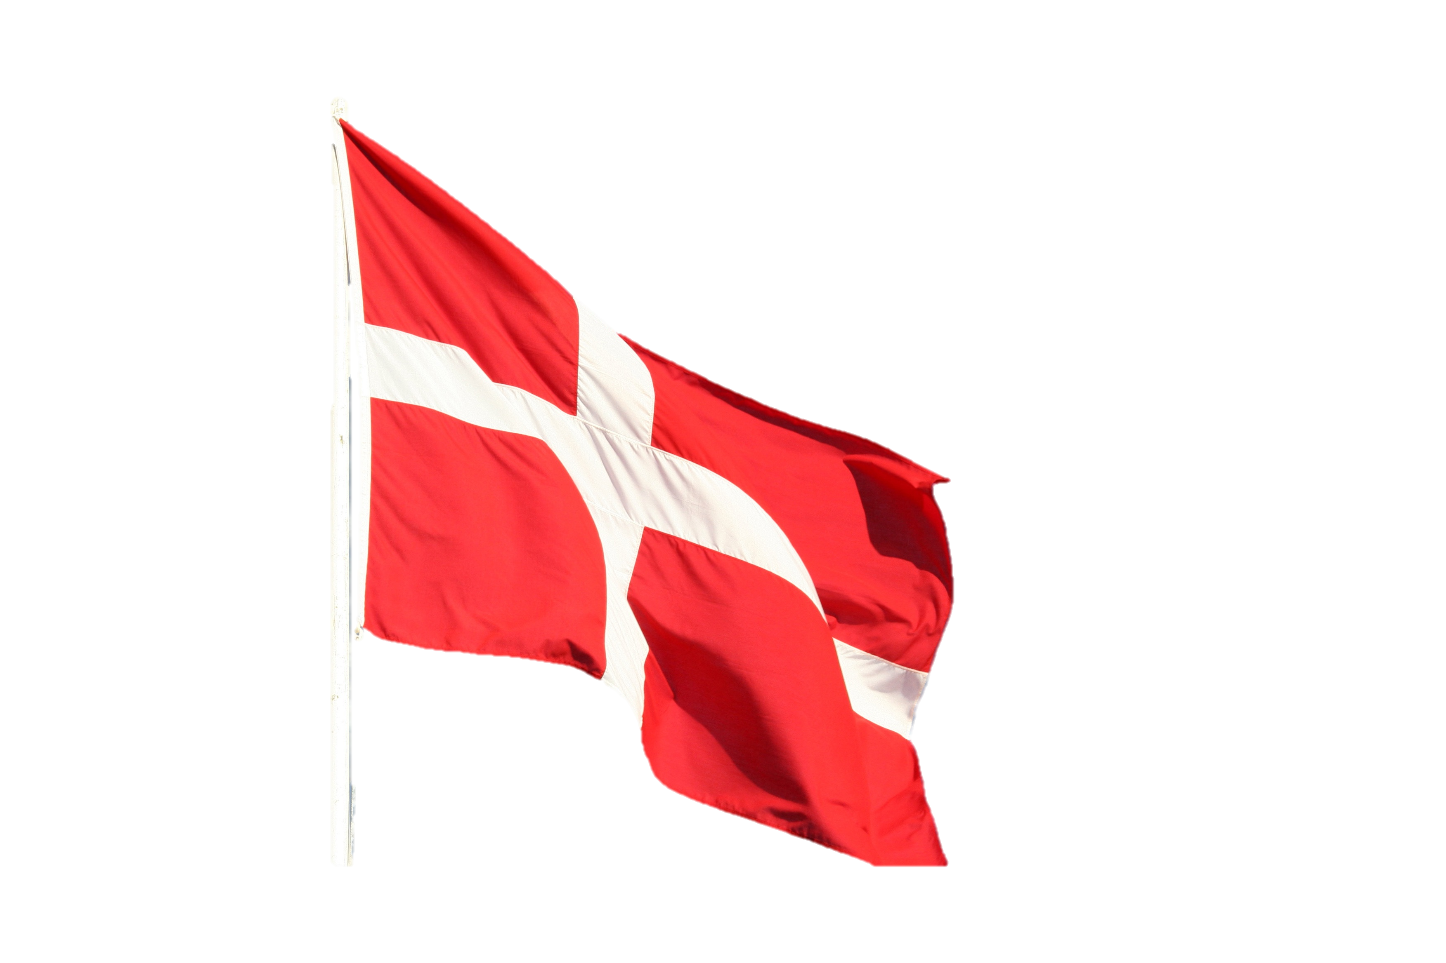

Key Examples of Countries in Europe have their own Policies related to the Carbon emission reduction and Carbon Trading
5.Denmark
Government Promotion of energy saving/reduction of CO₂:
Subsidies to promote energy savings/reduced CO₂ emissions: A major focus of the initial schemes was to reduce Denmark’s dependency on imported fuels. The major objectives of the subsidies that are currently in place are to promote cleaner fuels, to encourage energy savings in general, and to reduce CO₂ emissions
Government promotes green energy solution houses & provides subsidies. It has been one of the major driving forces behind the fact that most houses are very well insulated today. Another important fact is that building standards for new houses include insulation requirements.
6.Greece
Emissions of greenhouse gases (carbon monoxide and dioxide, methane and nitrous oxide) in the construction sub-sector stood at 419,183.5 tonnes in 2019, representing a decline of 54.0% over the 2010 level (911,729.3 tonnes). Similarly, in the real estate sub-sector, the emissions of greenhouse gases reduced by 15.5% from 6,952.0 tonnes in 2010 to 5,875.9 tonnes in 2019

Slide 62

Key Examples of Countries in Europe have their own Policies related to the Carbon emission reduction and Carbon Trading
7. Poland:
LEMUR (energy-efficient public buildings) aims at reducing energy consumption, and in consequence CO2 emissions, by designing and construction of new energy-efficient public buildings.
E-KUMULATOR (Ekologiczny Akumulator dla Przemysłu), supports initiatives for companies in the framework of low-emission and resource-efficient economy, and aims at reducing negative impact on the environment. In the component “reducing use of primary resources”, initiatives that quali for this support consist for example in construction or modification of installations in order to use less primary resources, use of secondary materials or use of technologies that reduce waste generation.
For Instance, KAWKA, aims at replacing coal stoves by low-emission heat sources, the objective is to increase energy efficiency and develop dispersed renewable energy sources.

Slide 63
Xella Business Case Study

Slide 64

About Company:
Xella stands for healthy, sustainable, and affordable housing and construction. They put emphasis on the improvement of the sustainability of buildings throughout their entire life cycle and contribute to a low-carbon, humane (construction) industry compatible with a circular economy.
Their R&D team continuously working on to support energy efficient, cost-effective, and sustainable construction, housing, and living. For this reason, for same they have sharpened their sustainability strategy and focused on how they can add the greatest-possible value.
Xella, leader in AAC Market, also strongly diverging with [70-80]% in North Germany, [40-50]% in East Germany, [20-30]% in West Germany and [5-10]% in South Germany.
AAC large format prefabricated compound units (“AAC large format units”), which are made of the same material as AAC blocks but require equipment such as cranes for handling. Xella markets AAC large format units under the Ytong and Hebel brands. The AAC large format units include aerated concrete ceiling and roofing panels, firewalls and outer walls and can roughly be divided into AAC large format units for residential construction (Ytong brand) and industrial/commercial construction (Hebel brand)

Slide 65
Xella owns total 95 Number of plant & have their footprints in 25 countries
Xella’s Autoclaved Aerated Concrete materials are characterized by ultra-efficient thermal insulation, optimum fire protection, and a high load-bearing capacity. They sell their product with the following brand name
• Ytong: AAC
• Multipor: mineral insulation boards for indoor and outdoor use
• Hebel: large-scale wall elements and roofing panels
Xella Offers Digital planning service, which offers all the services that make a construction project easier, faster, and more cost-effective from the outset, from 3-D project planning to optimized material choices and individual pre-picking

Slide 66
Building-Materials Industry of which EAACA is a Part
• Verband Bauen in Weiß, VBiW (White Material Construction Association)
• European Aerated Autoclaved Concrete Association, EAACA
• European Calcium Silicate Producers Association (ECSPA)
• Deutsche Gesellschaft für Mauerwerks- und Wohnungsbau e. V., DGfM (German Society for Masonry and Housing Construction)
• Bundesverband der mineralischen Bauprodukte, BBS (National Mineral Building Product Producers Association)
• Deutscher Ausschuss für Mauerwerk e. V., DAfM (German Masonry Committee)
Trends & Development
Xella’s Product under URSA insulation targets Stronger use of recycled and reprocessed materials by 2030, i.e. >80% mineral wool* & 50% XPS**
Reduction of CO2 emission intensity (scope 1 and 2) by 2030*, & 4.0 % reduction of CO2 intensity (vs. 2019)
AAC cutting waste and scraps from their own production, which are crushed into AAC granulate and then immediately returned to AAC production. This is our most frequent type of reuse. Xella Research and Development consistently works on raising the proportion of AAC granulate as a substitute for primary raw materials without modiing the properties of Xella products, they collect leftovers from their customers’ construction sites, purchasing material from horizontal competitors ,& Old AAC from building rubble.

Slide 67
Xella’s 2/3rd share of sales with sustainable products
They use recycled materials to manufacture new products & have find a alternative use for materials that cannot return to production processes at the end of their life cycle. As a consequence, AAC powder and granulate can be used as a raw-material substitute for other building materials such as cement or for new products. AAC serves as a binding agent for oils and chemicals, as loose-fill insulation for drywall, or particulate for environmental uses, even for kitty litter. We use only cutting waste and scraps for products such as these
In totality, wastewater-recovery rate is currently about 56%, In the Insulation business unit in particular, 94% of water is already treated and returned to the production process. More water is required for the formulas in the Building Materials business unit, which has a recovery rate of 51%.
Xella products consist mainly of natural raw materials and do not cause any notable volume of hazardous waste. Hazardous-waste management is a requirement that must be met in order to have production plants approved for operation. The volume of waste from hazardous substances was under 1% in 2020 based on the Basel Convention. That comply with statutory provisions and limits for any environmental impact factors such as noise, air, water, and wastewater

Slide 68
Plastics Recycling: To increase the recyclability plastic packaging, they began switching to film packaging for building materials in late 2020. In the future, they are planning packaging film to be only 10% printed color and the other 90% transparent so that it can be recycled better. The rollout is continuing in Belgium and France after a successful pilot project in the Netherlands and will progressively continue to all Xella countries. Furthermore, they offer their customers various services, for example in Germany they have arranged for film packaging to be picked up from construction sites and disposed of professionally
Xella is systematically directing their value-adding toward resource conservation and recyclability, they have paved the way for an environmentally friendly, future-proof business model
They purchased Raw materials from the local region (for Short-distance procurement ) – for short freight routes and a strong local economy
Their products have high thermal-insulation performance and deliver cost advantages from modular, highly standardized, and digitized production methods, letting them enable affordable housing that satisfies the energy-efficiency requirements of today and tomorrow, thus making a significant contribution to the social aspect of sustainability
They have focused on innovation and continual improvement & believed that they can have the perfect preparation for the challenges of the future in achieving an environment- and human-friendly economy.
Risk & Opportunity

Slide 69
ESG (Environmental, Social & Governance) Performance Directives
Environmental:
Expansion of energy-efficient production processes and technologies
Increased proportion of renewable forms of energy
Increase of recycled materials in product manufacturing
Improved circular-economy compatibility in our products and processes
30% reduction of CO2 emission intensity (scope 1 and 2) by 2030*
Minimum 80% of input from recycled and reprocessed glass in mineral wool production by 2030
Social
0 occupational accidents
40 % reduction of lost-time injury frequency rate by 2025*
25 % share of female managers at Group level by 2025
10% increase in annual training hours per employee by 2025*
Occupational safety and health
Development and performance of our employees
Diversity and equal opportunity in the working world

Slide 70
ESG (Environmental, Social & Governance) Performance Directives
Governance
~100% of relevant suppliers comply with Supplier Code of Conduct
Zero tolerance toward fraud, bribery, and anticompetitive activities
Customer experience and satisfaction
Improvement of sustainability performance in the supply chain
Increased awareness and training about compliance

Slide 71

Competitive Landscape

Slide 72
Europe Autoclaved Aerated Competitive Landscape Overview
Europe Autoclaved Aerated Concrete Market Share, By Company, By Value, 2020
Europe Autoclaved Aerated Concrete Production Capacity by Key Players,2021
Company | Production Capacity (m^3) per year
Xella | 9,900,000
Tarmac | 1,500,000
H+H | 2,720,000
AKG | 1,713,960
Solbet | 2,500,000
Note:- based on domestic production & sales-based market size, excluding export sales

Slide 73
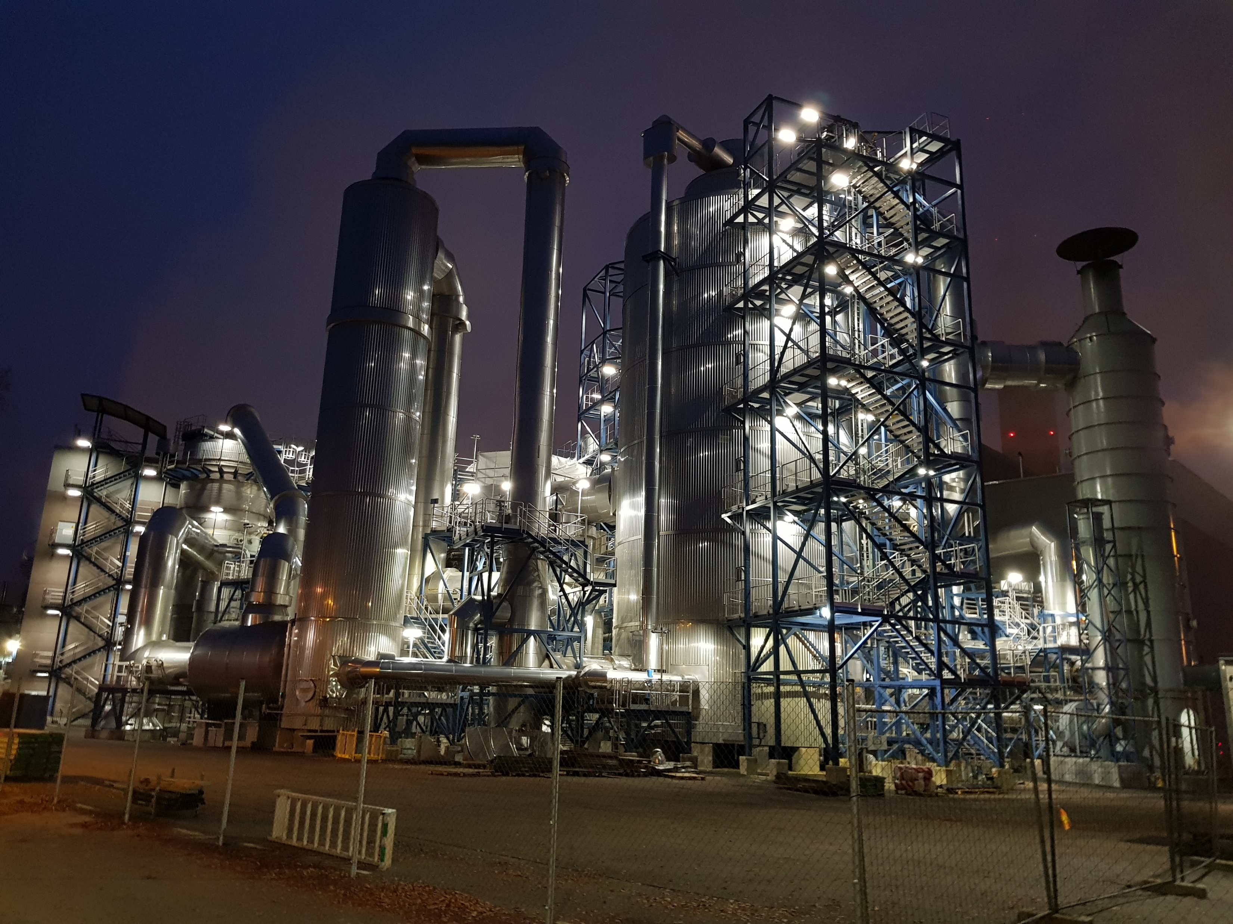
AAC Manufacturer Profiles
EXECUTIVE SUMMARY

Slide 74

Competitor Profile (Xella)
COMPANY DESCRIPTION
Business Overview:
Xella distributes AAC large format units under the Ytong brand for residential construction by way of project sales through retailers, but not directly to end- customers.
AAC large format prefabricated compound units (“AAC large format units”), which are made of the same material as AAC blocks, but require equipment such as cranes for handling. Xella markets AAC large format units under the Ytong and Hebel brands. The AAC large format units include aerated concrete ceiling and roofing panels, firewalls and outer walls and can roughly be divided into AAC large format units for residential construction (Ytong brand) and industrial/commercial construction (Hebel brand)
Xella’s market shares are also strongly diverging with [70-80]% in North Germany, [40-50]% in East Germany, [20-30]% in West Germany and [5-10]% in South Germany,
BASF’s EB business, through its EBA business, manufactures chemical-based admixtures. Some of these products (as well as the ones manufactured by BASF’s EB business upstream competitors) are used in the manufacture of several building and insulation materials manufactured by Xella
Product Portfolio:
Building Materials
Non-flammable Mineral Insulation
Insulation Materials (based on mineral wool
and extruded polystyrene)
Operating Brands:
Ytong: AAC Blocks & Slabs
Silka: Calcium Silicate Bricks
Multipor: mineral insulation boards for indoor and outdoor use
• Hebel: large-scale wall elements and roofing panels
Key Industries Served
Civil Buildings
Commercial
Infrastructure
Residential
Key Competitors:
Saint Gobain
H+H
Mannok
Bourac
Tarmac
Year of Establishment: 2002
Total Number of Employees (2020): 7,095
Total Revenues (2020) – USD 1.71 Billion
Germany –(Approx. 28% of Group Revenues)
AAC Revenues – (Approx. 40% of Group Revenues ~USD 719.5 Million of which 52% is contributed by Blocks, 38% slabs and 10% flooring panels
COMPANY HEADQUARTERS LOCATION
Düsseldorfer Landstrasse 395
47259 Duisburg, Germany

Slide 75
Competitor Profile (Xella)
RECENT DEVELOPMENTS
Xella emphasis on reusing materials in their our own products
The company employ various methods to reuse materials:
• AAC cutting waste and scraps from their own production, which are crushed into AAC granulate and then immediately returned to AAC production. This is our most frequent type of reuse. Xella Research and Development consistently works on raising the proportion of AAC granulate as a substitute for primary raw materials without modiing the properties of Xella products. Additionally, Research and Development works with its colleagues in Technology to develop processes and invest in machines so as to ensure better usage of our products’ recyclability.
• Leftovers from their customers’ construction sites
• Purchasing material from horizontal competitors that have not established a circular economy. The company purchased roughly 16,000 m3 of additional AAC material in 2020.
• Old AAC from building rubble so that these buildings become raw-material suppliers. To this end, we began a pilot project with a waste-disposal specialist to separate out
Xella’s team continuously working on new materials, optimize proven recipes and improve the properties of construction and insulation materials..
Xella Invested over 5 million euros in research and development during 2020, 75% of which went to environment- and climate-related research.
AAC Raw Material, like Manufacturing limestone and cement is a CO2 intensive business – that is why researching recipes and methods to reduce the amount of these raw materials in the products are subjected to the qualitative and quantitative phase inspections..
Xella T&F became an accredited testing center in 2011. It is responsible for quality control, building material testing, and compliance with the Construction Product Regulation for the European market. The product inspection covers both our own aerated concrete, sand-lime brick and mineral insulation board products, and external customers’ products
Xella Focuses on: Environmental Compliance Measures via following:-
Expansion of energy-efficient production processes and technologies
Increased proportion of renewable forms of energy
Increase of recycled materials in product manufacturing
Improved circular-economy compatibility in our products and processes
30% reduction of CO2 emission intensity (scope 1 and 2) by 2030*
Minimum 80% of input from recycled and reprocessed glass in mineral wool production by 2030

Slide 76

Competitor Profile
(H+H International)
COMPANY DESCRIPTION
Business Overview:
H+H International A/S is a wall building materials provider. The company's core activity is the production and sale of autoclaved aerated concrete (AAC or aircrete) and calcium silicate units (CSU or sand-lime bricks). The products are building blocks used for wall building the residential new building segment. The product range also includes products such as high-insulating blocks, larger elements and a range of traded goods used for wall building. The company has around 29 factories in Northern and Central Europe with a total annual output of approximately four million cubic meters of wall building materials.
H+H group operates in the following market (H+H, 2009): UK, Germany, Denmark, Belgium and the Netherlands, Poland, Czech Republic, Russia, Ukraine, the Baltic States and Slovakia, Finland, Sweden and Norway
Product Portfolio:
Commercial & Industrial Buildings
Infrastructure
Residential Buildings
Product Availability
Subgrade Waterproofing
Wall systems
Flooring system
Key Industries Served
Civil Buildings
Construction
Infrastructure
Residential
Key Competitors:
Xella
Mannok
Bourac
Year of Establishment: 1909
Total Number of Employees (2020): 1500+
Total Revenues (2020)- 460.4 USD Million
AAC Sales – 68% of Total Revenues
COMPANY HEADQUARTERS LOCATION
H+H International A/S Lautrupsgade 7, 5th Floor 2100 Copenhagen, Denmark

Slide 77
Competitor Profile (H+H International)
RECENT DEVELOPMENTS
GROWTH STRATEGIES
The H+H Group ("H+H”) has signed an agreement to acquire 52.5% of the shares in DOMAPOR GmbH & Co. KG (“DOMAPOR”), a German manufacturer of aircrete and calcium silicate blocks located in Mecklenburg-West Pomerania.
The acquisition is in line with H+H’s strategy to expand its activities within the German wall-building materials market and further consolidate and restructure the industry
H+H made meaningful strides in 2020 and started the year by taking yet another step in the right direction on strategic growth journey by closing the acquisition of the majority shareholding in Porenbetonwerk Laussnitz GmbH & Co. KG, a German AAC unit business. Company aims to deliver innovative solutions through a network of global and regional R&D centers.
The company made meaningful strides in 2020 and started the year by taking yet another step in the right direction on strategic growth journey by closing the acquisition of the majority shareholding in Porenbetonwerk Laussnitz GmbH & Co. KG, a German AAC unit business.

Slide 78

Competitor Profile (Tarmac)
COMPANY DESCRIPTION
Business Overview:
Tarmac is the UK’s leading sustainable building materials and construction solutions business.
The company have contributed to some of the UK’s biggest construction projects, including The Sainsbury Laboratory, Wembley Stadium, Heathrow Terminal 5, Blackpool Sea Defences, The Shard and London 2012.
The company directly employs around 7,000 people across a nationwide network of over 400 sites. Also there solutions span aggregates, asphalt, cement, lime, offsite manufacturing, readymix concrete, road contracting services, building products and recycling services.
The company are one of the largest recyclers of construction materials in the UK and a net consumer of waste. Tarmac is part of CRH plc.
PRODUCT PORTFOLIO
Product Portfolio:
Building, Construction & Infrastructure
Chemical Manufacturing & Industrial
Agriculture
Product Availability
Building materials & Components
Construction chemicals
Flooring & surfaces
Screed, Soils,
Specialty Product
Key Industries Served (w.r.t. Product of Interest):
Buildings
Infrastructure
Road Construction
Year of Establishment: 2013
Total Number of Employees (2020): 26,800
Total Revenues (2020) – 2.8 Billion USD
AAC Sales –8% of Total Revenues
Key Competitors:
Xella
•H+H Internation
•Solbet
COMPANY HEADQUARTERS LOCATION
Bickenhill Lane, Portland House,
Solihull, B37 7BQ
0121 787 5001

Slide 79
Competitor Profile (Tarmac)
RECENT DEVELOPMENTS
ASPIRATIONAL TARGETS
Buildings and infrastructure account for over half of the UK’s greenhouse gas emissions, There sustainability strategy is to move towards low and zero carbon following the Government's target to reduce greenhouse gas emissions to ‘net zero’ by 2050.
Tarmac had focused on recent digital transformation to improve customer experiences, so that customer should have Connect on their platform for 24/7 account access, self-service data on payments and order tracking. The programme also includes process improvements for deliveries, material quality assurance and order tracking.
Tarmac combines the knowledge and expertise of two of the construction industry’s provide the best possible Product.
The company have developed a sustainability strategy based around four strategic themes: People, Planet, Performance and Solutions. Against each of these themes we have identified key priority areas of focus and, set ambitious commitments, alongside specific milestone targets and detailed performance targets
Tarmac Specialises in the supply of construction, highways and building materials for contractors, trade and end users. The company are targeting to Enhance the Quality with sustainable solution & increase portfolio of production.
Tarmac is commitment to enhance customer service and, to continually improve customers' experiences
Tarmac gives emphasing on the improvement for all of their employees and contractors by building a zero harm culture that prioritises people's health, safety and well-being, and targets continuous improvement

Slide 80
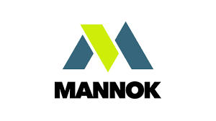
Competitor Profile (Mannok)
COMPANY DESCRIPTION
PRODUCT PORTFOLIO
Business Overview:
Mannok, formerly the QUINN group, is a business group headquartered in Derrylin, County Fermanagh, Northern Ireland.T
The group has ventured into cement and concrete products, container glass, general insurance, radiators, plastics, hotels, and real estate
It was formed by Seán Quinn in 1973, developing from a small quarrying operation in Derrylin into a large organization
Year of Establishment: 1989(first venture into the cement industry )
Total Number of Employees (2020): 8000
Product Portfolio:
Thermal Blocks
Roof Tiles
EPS & PIR Insulation
Cemant & Precast
Quarry & Aggregate
Product Availability
Insulation Board
Aircrete Thermal Block
Concrete repair material
Key Industries Served
Construction industry
Industrial building
Key Competitors:
H+H International
Xella
Solbet
COMPANY HEADQUARTERS LOCATION
187 Ballyconnell Road, Derrylin, Enniskillen, Co. Fermanagh, BT92 9GP Tel: + 08000 322 122 (UK), 1800 322 122 (ROI)

Slide 81
Competitor Profile (Mannok)
RECENT DEVELOPMENTS
GROWTH STRATEGIES
Rebranding to Mannok marks 5-year transformation and investment programme that has repositioned the business as a provider of increasingly sophisticated and sustainable building and packaging solutions, supporting an increase in sales of over 30 per cent during the period (Earnings (EBITDA) increased from €26.4m to €26.6m, despite Brexit H2 challenges
Mannok work on achieving true operational excellence, as per company, it is not enough to make improvements once. It must be an ongoing process, where the business continually strives to improve how it operates and seeks to do everything better. operating performance for the 12 months ended 31 December 2019 showed another increase in earnings (EBITDA – Earnings Before Interest, Tax Depreciation & Amortisation) to €26.6m, with an investment increase to €11.5m.
Mannok’s latest sustainability initiative reduces electricity use in its precast stairs curing process by 50%
The Company has initiated efforts towards development of a sustainability roadmap throughout every part of their business.
This core value coupled with innovative spirit drives them relentless pursuit of environmental excellence constantly evolving through technical innovation, providing pioneering, cost-effective construction solutions which are designed to meet the needs of any construction project
Their core philosophy of producing high quality products and offering first-rate service at competitive prices, o showcase best practices in manufacturing for the UK, Ireland, and beyond

Slide 82
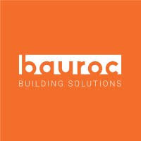
Competitor Profile
(BAUROC)
COMPANY DESCRIPTION
Business Overview:
Bauroc is the largest producer of aircrete i.e. autoclaved aerated concrete (AAC) products in the Northern Europe
Bauroc operates two state of the art AAC factories in Estonia and Latvia and sells its products in all Baltic and Nordic countries but also in Poland, Germany and Switzerland under “bauroc” and “ROCLITE” brand names.
Bauroc products can be used everywhere in construction starting from private houses, but also in multistore, agricultural and industrial buildings. Word “bau” is “construction” in German language and second part of the word “roc” means, that we make all our products from ecological stone material – natural mineral-based autoclaved aerated concrete.
Bauroc is long time member of European Autoclaved Aerated Concrete Association – EAACA
Product Portfolio:
block products, reinforced lintels
large roof
wall elements
dry mixes and accessories for installing the products
Product Availability:
Bauroc ECOTERM, CLASSIC, UNIVERSAL, ELEMENT,
U-BLOCK, Bauroc LINTEL, Bauroc ROOF PANELS ,Bauroc WALL PANELS
Bauroc THIN JOINT MORTAR, Baurac Easyfix Baurac
Repair Mix,
Key Industries Served
Building, Residential Sector
Civic Construction
Key Competitors:
Xella
H+H international
Solbet
ISOLTECH
Estimated Production Capacity (2021)- 175,000 m³
Estimated Revenue:- USD 21.23 Million
Year of Establishment: 2001
Total Number of Employees (2020): 245
COMPANY HEADQUARTERS LOCATION
Väike-Männiku tn. 3, 11216 Tallinn, Estonia
+372 679 9080
bauroc@bauroc.eu

Slide 83
Competitor Profile (BAUROC)
RECENT DEVELOPMENTS
GROWTH STRATEGIES
Bauroc is the first manufacturer of building blocks in the Baltics to have Environmental Product Declarations (EPDs) issued.
SIA MONUM is continuing with the second stage of construction for project “Mārupes nami” in Mārupe, Latvia. In order to speed up the pace of construction and achieve better thermal insulation of the external wall, Bauroc CLASSIC 3MPa blocks were selected as the most suitable product for this purpose. Bauroc LINTELS were used to bridge the door and window openings bauroc WALL PANELS were used in the construction of a firewall built between the old and new building of the Sagax Finland warehouse center in Vantaa, Finland.
The structural part of Jämerä houses is built from aerated concrete products produced in the Bauroc factory.
The company aims to increase its productivity by optimizing global operations.
The company provides Cheaper price for AAC & it has wide range of AAC Product ( around 21 No’s)
The company aims to strengthen its position by investing in R&D activities/ Environmental Protection which focuses on commercializing differentiated products & solution and creating new product categories.

Slide 84

Competitor Profile (SOLBET)
COMPANY DESCRIPTION
Business Overview:
SOLBET is a Polish leader and the largest producer of autoclaved aerated concrete (AAC) in Poland – up to 1/3 of domestic production of AAC comes from SOLBET factories.
Current production capacities of all Group facilities reach 2,5 million cubic meters of AAC and other products per year. The Group’s largest plant and headquarters located in Solec Kujawski is the European record holder in daily production of AAC – every day the plant provides 2500 m³ of its products on the market.
SOLBET brand is known throughout the continent, including Germany, Denmark, Sweden, Norway, Belgium, the Czech Republic, Russia, Hungary, Slovakia, Lithuania, Latvia, Ukraine and Croatia. Such a huge scale of production is the result of over 70 years of activity that involves constant development and improvement of its products, as well as expansion of its product range.
SOLBET, in addition to AAC, also produces building chemicals – mortars, plasters and adhesives. Above all, a wide range of these products allows for a systemic construction using AAC, but also allows for the use of some SOLBET products in other technologies.
Year of Establishment: 1951
Total Number of Employees (2020): 250+
NET Revenue in 2020
Total – 28.4 Million USD
Product Portfolio:
AAC U-Blocks
Boards
Mortar
Key Industries Served
Residential
Commercial
Key Competitors:
Bauroc
Xella
H+H
COMPANY HEADQUARTERS LOCATION
Toruńska 71 Street
86-050 Solec Kujawski
+48 52 387 42 11

Slide 85

Competitor Profile (ISOLTECH SRL)
COMPANY DESCRIPTION
PRODUCT PORTFOLIO
Business Overview:
Isoltech is a leader in Italy in the production and installation of foam concrete. Lightweight Cellular Concrete, also known as foam concrete, is the ideal lightweight solution for design needs, and offers a strong cost/value advantage for lightweight fill construction. The use of the most modern, high production equipment offers the end user the most productive, cost-effective solution in the industry today.
Isoltech was one of the first Italian companies to introduce in the market foaming agents to produce cellular concrete, which started to spread in the early 1970s.
The company are one of the pioneers to promote this industry and their services are not limited to the supply of products , plants or machinery rather open to provide complete consultancy for any related foam concrete projects.
Year of Establishment: 1970
Total Number of Employees (2020): more than 10,500 (Global)
Product Portfolio:
Cellular Concrete
Foam Concrete
Concrete Blocks
Cellular Lightweight Concrete
Key Industries Served (w.r.t. Product of Interest):
Building
Construction
Key Competitors:
Sika
Pidilite
MBCC group
Henkel
COMPANY HEADQUARTERS LOCATION
Via Berlino, 26 Verdellino, BergamoTel: 39 - 035 – 4820680

Slide 86
AAC Production Equipment/ Plant Manufacturer Profiles
EXECUTIVE SUMMARY

Slide 87
European Competitive Landscape – Top 10 AAC manufacturing equipment makers Revenue Ranking & Market Share, 2020
Company | Revenue (2020) USD Million
Aircrete Europe | 405.8
TOP WERK Group Total Revenues | 243.3
Masa Henke | 123.6
HESS Group (manufactures concrete block making machines ) | 61.1
ZENITH Maschinenfabrik GmbH | 29.7
HESS AAC SYSTEMS (ACC Plant ) | 24.4
REKERS GmbH Maschinen- und Anlagenbau | 23.3
PRINZING PFEIFFER (machines for concrete infrastructure products.) | 17.4
SR SCHINDLER (tile presses and value adding lines) | 16.3
WKB Systems GmbH | 13.3

Slide 88

Competitor Profile (Aircrete Europe)
COMPANY DESCRIPTION
Business Overview:
Aircrete Europe is the leading vendor in design & manufacturing of AAC plants in Europe and Overseas Markets and has been known to install 100 plants worldwide till date
The company is known to deliver the most innovative turn-key AAC plants and cutting-edge plant technology around the world. The company give guidance through all the steps of planning, building and operating AAC factory. The company are a full technology partner, not just a machine supplier, resulting in maximum value creation for their customers such as H+H International, Aeroc
Year of Establishment: 2002
Total Revenues (2020) – 405.8 Million €
Core Expertise:-
Plant Design, Installation & Commissioning
Aftersales Repair and Maintenance
Upgrade & Modernization
Modular & Custom Designs
Key Competitors:
Masa Henke
Wehrhahn
Hess AAC

Slide 89
Competitor Profile (Aircrete Europe)
RECENT DEVELOPMENTS
Aircrete Europe and Aircrete China have proudly completed their first AAC plant project for Zhejiang Yuanzhu Housing Industrialization Co. Ltd. (Yuanzhu), a subsidiary of Dingyuan Group and a leading building material producer in China with production capacity of 500,000 cubic meters per year. It is Aircrete´s most advanced AAC production line in China, with the highest level of automation, new AAC panel production features and an intelligent AAC plant control system, which is a response to China’s growing demand for AAC panels.
Aeroc Ukraine chooses Aircrete as a trusted technology partner for the production of autoclaved aerated concrete products with a capacity of 480,000 m3 per year.
The company is incorporating Industry 4.0 operating suite in upcoming plant designs in achieving resource optimization techniques for production of AAC
Active participation in trade fairs & conferences and affiliations with industry council os being pursued by the company to consolidate its brand footprint amongst the AAC providers
The company is with help of its affiliated customers is also promoting and advertising green prefab AAC panels so as to gain recognition in green materials solution provider

Slide 90
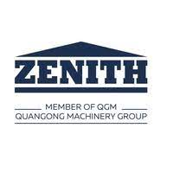
Competitor Profile ZENITH Maschinenfabrik GmbH
Business Overview:
ZENITH Maschinenfabrik GmbH in Neunkirchen is leading manufacturers for the concrete block industry in Germany. The company more than 8,000 satisfied customers worldwide till date.
The company is engaged in providing machines of highest quality, individual and tailor-made turnkey concrete block plants for future-orientated production. Everything from a single source
ZENITH offers: from consulting to plant construction and machinery, from transport systems for concrete and finishing systems to extensive service offers (such as training and maintenance and modernization of existing manufacturers
COMPANY DESCRIPTION
Product Portfolio:
Multilayer Machines
Single Pallet Machine
Travellers
Single Pallet Plant
Key Competitors:
Masa Henke
Wehrhahn
Hess AAC
Aircrete
Year of Establishment: 2014
Total Number of Employees (2020): 120
Total Revenues (2021) – 29.72 Million USD

Slide 91
Competitor Profile ZENITH Maschinenfabrik GmbH
RECENT DEVELOPMENTS
GROWTH STRATEGIES
Despite of Covid 19 Pandemic, production lines at Zenith Maschinenfabrik in Neunkirchan ran at full speed & did good business deals like
Replaced stationary Zenith 844 multilayer machine had been in operation for 38 years with new Statoney multilayer Machine at Betonwerk Strauch .
Zenith Maschinenfabrik from Neunkirchen has accepted an order from the Toguna Group to set up a Zenith 1500-2 high- performance single pallet machine in Bamako
.
Zenith Maschinenfabrik focus on providing the customer centric product & service.
From last 6 decades The company are focusing on the R&D of non pallet block machine and today Zenith has become the worldwide leader in non pallet block machine manufacturing industry.
Having good product portfolio & lot of experience makes them one of the pioneer in this industry, this includes around 8000 customer believe in the Zenith product.

Slide 92

Competitor Profile Masa
COMPANY DESCRIPTION
Business Overview:
With decades of experience and continuous developments, Masa builds efficient, high output, and enduring production facilities for the worldwide building materials industry. The century old company, filled with legacy and industry innovations, offers tailor made production plants for manufacturing a multitude of products utilising a variety of technologies including: AAC, sand lime brick, and an array of dry-cast concrete products (I.e. hollow blocks, kerbstones, paving stones, and hardscape products). Products can be individually customised to produce an assortment of shapes, colours, and sizes with few limitations. In addition to new plant installations, retrofit projects for single plant components, and customer-oriented service and support programs make up a significant portion of Masa’s portfolio of capabilities. To further support customers around the world the two German production facilities in Andernach and Porta Westfalica and subsidiaries in USA, China, Russia, UAE, India, and Thailand are always available.
Year of Establishment: 1905
Total Number of Employees (2020): 500
Total Revenues (2020) – 123.6 million USD
Product Portfolio:
This include machine for the production for the below items
Concrete block production
Sand lime brick production
AAC production
Kerbstone production
Key Competitors:
Aircrete Europe
Wehrhahn
Hess AAC
ZENITH Maschinenfabrik GmbH

Slide 93
Competitor Profile Masa
RECENT DEVELOPMENTS
GROWTH STRATEGIES
Masa is able to look back on more than 100 years of company history. Their experience, the quality of products and the constant dialogue with partners have contributed to the success of customers worldwide.
Russian manufacturer Porevit expands capacities making MASA group as the project partner in terms of Machine delivery (The production capacities of the state-of-the-art plant with three automated Masa production lines are about 300,000 m³ of AAC blocks, 110 millions of sand lime bricks and now also up to 900,000 m² of pavers per year)
Masa joins hands against Covid 19 & altered his logo, All with one message: Get vaccinated! We are also supporting this vaccination campaign.
Masa once again maintains its place in the world market leader ranking of the University of St. Gallen.
Masa group believe in quality of their products, with their experience The company habe significantly influenced many developments in the building materials industry.
with there extensive experience The company have subsidiaries for sales and services established worldwide: In USA, China, Russia, India, Thailand and Dubai, responsible for the Middle East..
The company provide highest quality of the known technology and the exact solution give a high-quality finished product. ( with putting efforts in initial planning principles apply in all fields of design and manufacturing.)

Slide 94
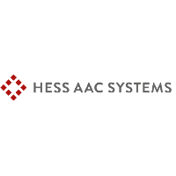
Competitor Profile HESS AAC System
COMPANY DESCRIPTION
Business Overview:
HESS AAC Systems B.V. possesses specific know-how on the design, assembling and building of machines and plants for the autoclaved aerated concrete industry worldwide. About thirty years ago HESS AAC became active on the AAC market, concentrating mainly on manufacturing, installing and maintaining the production machinery for the world market leaders in AAC. During this relationship HESS AAC SYSTEMS built several production lines for key customers in and outside Europe.
Their aim here is to meet the expectations of the customer and offer them the best price performance ratio. The company believe in offering a comprehensive package of standardized production systems, machines and services that has been developed through experience and innovation as the basis for customized solutions..
Year of Establishment: 1948
Total Number of Employees (2020): 852
Total Revenues (2020)– 174.2 Million USD
Product Portfolio:
Keen-Crete-KBT
• Compact Line-CBT
services such as end to end customized solutions, assistance with export credit through a European bank, support in business development, supply of equipment / plant machinery, comprehensive training of personnel on machine operation, as well as development of optimum AAC mix compositions
Key Industries Served
Provides design and production of plants and machinery for
Building materials industry.
Key Competitors:
Masa Henke
Wehrhahn
Aircrete Europe

Slide 95
Competitor Profile HESS AAC System
RECENT DEVELOPMENTS
GROWTH STRATEGIES
Hess AAC Systems supported MAK Euro Block in successful commissioning of their production plant
As in close collaboration with the Topwerk , HESS AAC SYSTEMS Mr Roland Schellenberger, based in Bangkok, Thailand, providing consultation and services for autoclaved aerated concrete (AAC) business
HESS AAC SYSTEMS with more than 40 years of experience in all different kinds of AAC production systems, offers guidance for the improvement of productivity and cost reduction as well as for the extension of the product portfolio..
Due to extensive operational as well as technological development over –recent decades, many production facilities for AAC find themselves to be outdated which effects quality, output, and costs. HESS system has seen opportunity in efficient production through modernized aerated concrete plants.
HESS AAC SYSTEMS provides a full range of services such as end to end customized solutions, assistance with export credit through a European bank, support in business development, supply of equipment / plant machinery, comprehensive training of personnel on machine operation, as well as development of optimum AAC mix compositions.The company provide highest quality of the known technology and the exact solution give a high-quality finished product. ( with putting efforts in initial planning principles apply in all fields of design and manufacturing.)

Slide 96

Competitor Profile TOPWERK
COMPANY DESCRIPTION
Business Overview:
TOPWERK GROUP is a globally operating technology leader in mechanical and plant engineering for the concrete block industry, it includes integrative and technical sophisticated complete solutions, planning, development, construction and design of equipment and machinery for the production and finishing of concrete construction materials.
Topwerk affiliated companies are HESS GROUP, SR SCHINDLER, PRINZING PFEIFFER, and HESS AAC SYSTEMS, which provide a complete range of machinery and systems for the production and post-processing of concrete block materials and sand-lime processing.
Product Portfolio:
Mixers, conveyors,
Concrete block machines
packaging lines
Finishing plants and hermetic slab presses
Plants for the production of aircrete
Concrete products in the field of infrastructure
Basic Engineering Package :
Parts and Products
Training Academy
Concrete Technology
System Inspection
Digital order processing of spare parts
Key Competitors:
Masa Henke
Wehrhahn
Hess AAC

Slide 97
Competitor Profile TOPWERK
RECENT DEVELOPMENTS
GROWTH STRATEGIES
TOPWERK GROUP, the world's leading manufacturer of machinery and equipment for the concrete industry, is currently carrying out a wide-ranging environmental protection project: under the motto "Corporate Environmental Responsibility", the group is implementing a variety of measures, including extensive building renovations. The aim is to make production at the German production sites in Burbach, Andernach and Porta Westfalica more environmentally friendly in the long term
TOPWERK GROUP’s subsidiary TOPWERK RUS has expanded expanded its production capacity in Russia as of 1st January 2022. In addition to the completely newly built production facility, also an existing building was extended.
.
To better meet the market requirements in south and east Asia, TOPWERK establishes TOPWERK ASIA in Ho Chi Minh City. With this location in the economic centre of Vietnam, the Group is consistently pursuing its growth strategy and the goal of offering better sales and after sales services in the Asian market.
Together with their customers, the TOPWERK GROUP actively shapes new working conditions for the construction materials industry. The main focus is to ensure the product quality and the automation of the manufacturing and production processes & ensuring work and communicate at an increasing speed

Slide 98
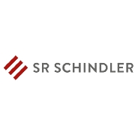
Competitor Profile SR SCHINDLER
COMPANY DESCRIPTION
Business Overview:
SR SCHINDLER is one of the globally leading providers of production machinery and value adding lines for the concrete industry. there are variety of concrete products and options combining e.g. the charm of natural stones with the advantages of industrial production. Their core business is the production of single machines or complete lines for the surface refinement of pavers, slabs, wall stones, angular steps and block steps.
Product range includes
Complete plants for production, value adding and packing of hermetic slabs
Value adding and packing lines for pavers and wall stones
The engineered lines are built up modular, making them flexible and expandable at low costs. As a technology leader and innovator The company integrate state of the art steering and visualization concept in production lines
Year of Establishment: 2002
Total Number of Employees (2020): 7095
Total Revenues – 16.25 Million USD
Product Portfolio:
Building Materials
Non-flammable Mineral Insulation
Insulation Materials (based on mineral wool
and extruded polystyrene)
• Ytong: AAC
• Multipor: mineral insulation boards
for indoor and outdoor use
• Hebel: large-scale wall elements and roofing panels
Key Competitors:
Masa Henke
Wehrhahn
Hess AAC
Aircrete Europe

Slide 99
Competitor Profile SR SCHINDLER
RECENT DEVELOPMENTS
SR SCHINDLER supplies new finishing line for concrete blocks and pavers at RAKNOR in Ras Al Khaimah, United Arab Emirates, Under the umbrella of Topwerk Group, SR SCHINDLER and HESS GROUP could present a fully automated and integrated plant, consists of RH 2000-3 MVA, SM3375 with 2x SM400 mixers, advanced multicolor system, shot-blasting, curling, coating and grinding and a fully automatic handling system, that is flexible and allows the production of pavers with the single or combined finish
Tobermore commissions new production plant with components from SR SCHINDLER. (Tobermore, the Northern Irish manufacturer of high-quality concrete products, has commissioned its fourth production plant with equipment from manufacturer of machinery Hess at its headquarters.)
SR SCHINDLER‘s After Sales Service is strengthened by the takeover of specialist firm SH STONETEC (SH STONETEC specializes in maintenance, service and retrofits of concrete products surface finishing machines and services a large customer base throughout Europe from their headquarters near Regensburg)

Slide 100
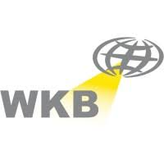
Competitor Profile WKB Systems GmbH
COMPANY DESCRIPTION
Business Overview:
WKB Systems is a medium-sized manufacturer of high-tech capital goods headquartered in Hörstel, North Rhine-Westphalia. The company specialized in the development of systems, machines and entire plants from the fields of aerated concrete production, sand-lime brick production, forging automation and brick processing.
WKB Systems offers a broad range of services for international customers: starting with the competent consultation and configuration of tried and tested solutions, through the design and manufacturing of systems up to the commissioning and staff training at the customer's location.
Product Portfolio:
AAC Production Plant
U-SHELLS GLUING STATION WITH PERFORATION DRILLING MACHINE
GRATE CLEANING MACHINE
SAND LIME BRICKS PRODUCTION
FORGE AUTOMATION
Key Competitors:
Aircrete
Masa Henke
Hess AAC
SR SCHINDLER
Topwerk

Slide 101
Competitor Profile WKB Systems GmbH
RECENT DEVELOPMENTS
GROWTH STRATEGIES
The company have equipped a completely new plant with machinery and equipment from WKB Systems at one of the largest aerated concrete producers in Turkey, Türk Ytong Sanayi A.S. at its site in Catalca. (Two in one: the combination of two different production lines under one roof This is A completely new plant concept & developed by the experts of WKB Systems)
The WKB specialists worked out a special concept for the packing area of this plant – separate packing lines for common AAC blocks and AAC panels/ lintels, incl. a sorting area. Both packing lines are based on the shuttle system. The shuttle transport system moves the whole AAC cake to separate the blocks into half-pack groups so the needed gaps for a palettizing robot arises
.
The company Extensive R&D team comes with wide variety of new product in to their portfolio e.g. GRATE CLEANING MACHINE, The use of our grate cleaning machine prevents the green bricks and hardened bricks from being scratched or damaged. In order to clean the grates of any caking, The company have developed a special grate cleaning machine
The company offer the production of U-shells and perforated blocks as an additional option. It is possible to integrate a single machine into existing AAC plant or as a stand alone production line
The company are continuously innovation of modernization concepts, The company believe in concept of even small changes are sufficient to achieve a significant increase in productivity and product quality

Slide 102
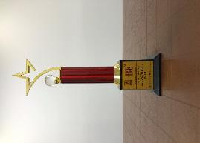
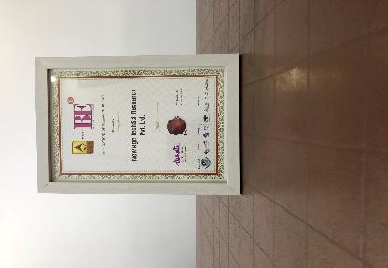
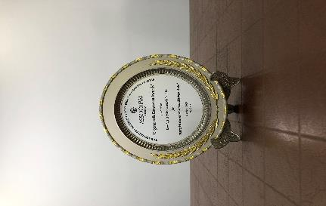
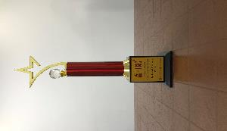
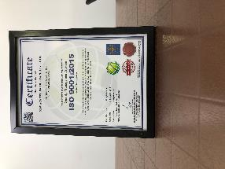
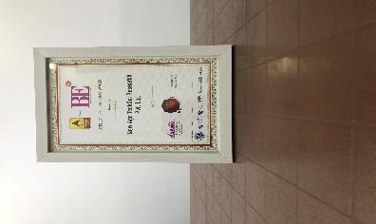
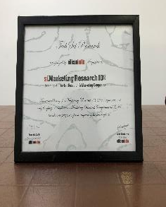
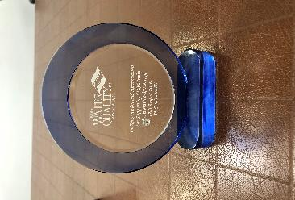
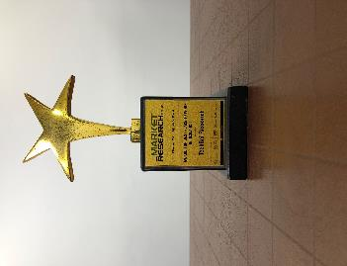
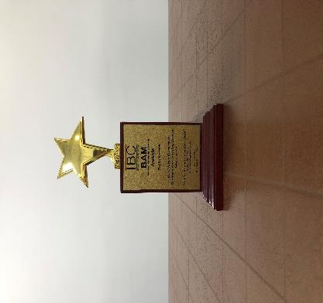
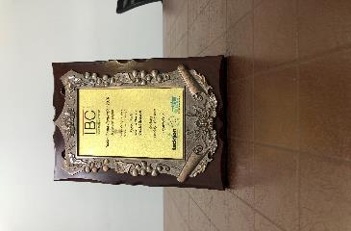
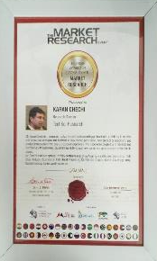
TechSci Research- Awards & Recognition
Best Application of Research Award at World Marketing Congress by ABP News ( 2018 )
Organic India Excellence Awards by ASSOCHAM India (2018)
Business-to-Business Research Award at Brand Excellence Awards by ABP News (2018)
Quality Management System by ISO (2018)
Best Application of Research Award at World Marketing Congress by ABP News ( 2017 )
Award for Best Place to Work in Research at World Marketing Congress by ABP News (2017)
Recognition from Silicon India Magazine
Recognition & Appreciation from WQIA
Best Market Research & Management Consulting Manufacturing Processby Wafisilpa Entertainments
Leadership Award from World Marketing Congress
Leadership Award from World Marketing Congress

Slide 103
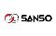
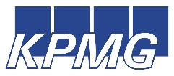


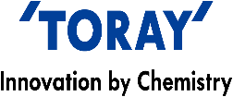



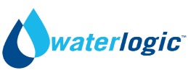







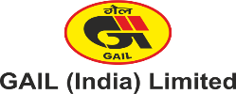
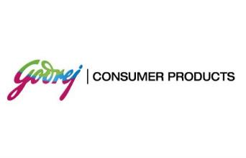
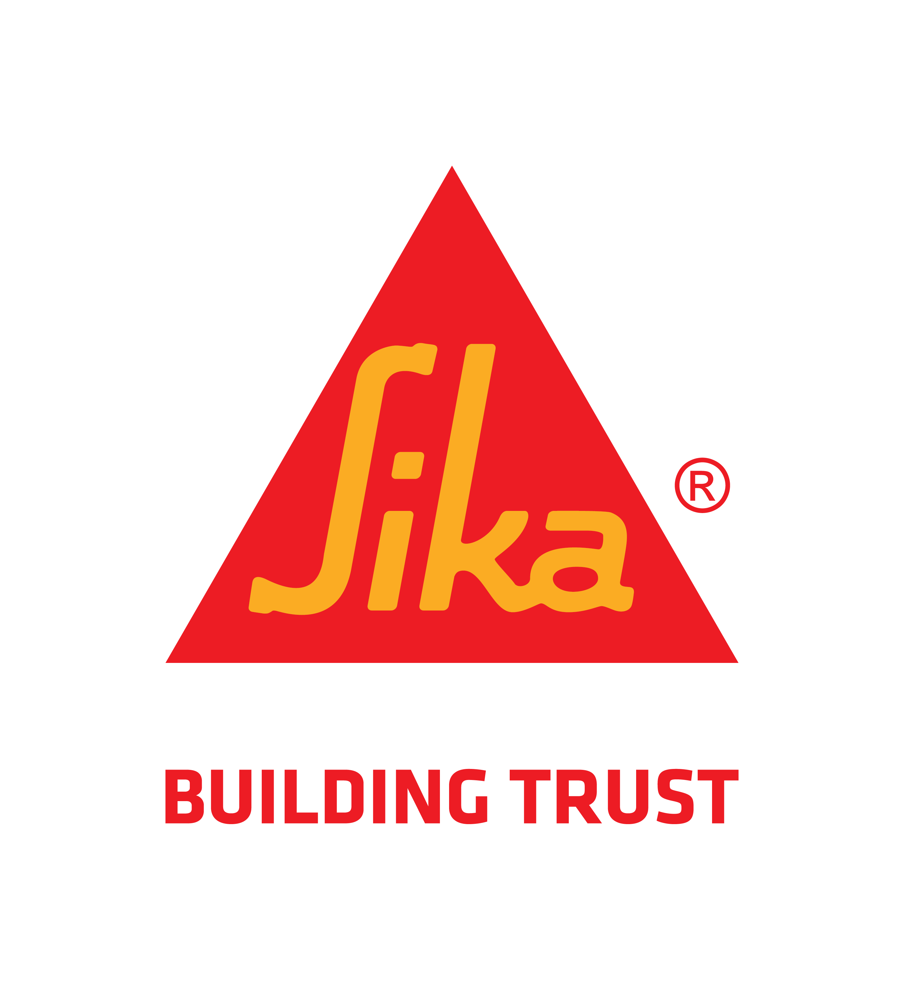



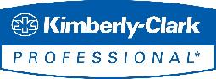






Our Prestigious Clients Who Bought Reports in Chemical Industry

Slide 104

TechSci Research – North America
708 Third Avenue, Manhattan,
New York, United States
Tel: +1- 646- 360- 1656
Email: sales@techsciresearch.com www.techsciresearch.com
TechSci Research – Europe
54, Old brook, Bretton,
Peterborough,
United Kingdom
Email: sales@techsciresearch.com www.techsciresearch.com
TechSci Research – Asia-Pacific
B – 44, Sector – 57, Noida, National Capital Region, U.P. - India
Tel: +91-120-4523900
Email: sales@techsciresearch.com www.techsciresearch.com
Thank you!!
We look forward to serving your research needs!!

